Slide 1

Webinar – Public Consultation
Draft Kildare County Development Plan 2023-2029

Slide 2
Planning Hierarchy
NATIONAL PLANNING FRAMEWORK
2016-2026
LOCAL AREA PLANS (Including Social Infrastructure Audits & Local Transport Strategies)
Naas, Maynooth, Newbridge, Leixlip, Kildare, Athy, Celbridge, Kilcock, Monasterevin, Sallins
INDIVIDUAL PROJECTS
SEA/AA
EMRA - REGIONAL SPATIAL AND ECONOMIC STRATEGY
2019-2031
DUBLIN
METROPOLITAN AREA STRATEGIC PLAN
SEA/AA
KILDARE LOCAL ECONOMIC AND COMMUNITY PLANS
2016-2021
KILDARE COUNTY DEVELOPMENT PLAN (Currently being reviewed)
STRATEGIC
DETAIL
SEA/AA
SEA/AA
EIA/AA

Slide 3
What is the purpose of the County Development Plan?
Sets out a framework for the proper planning and sustainable development of the county over a 6-year period
Takes into account EU, national and regional policy requirements
Ensures a coordinated approach to delivery of services in line with areas of projected growth
Funding opportunities are strengthened where specific objectives are listed in the Plan

Slide 4
What is a LAP?
LAP’s takes a very detailed look at a specific area and provide a land use planning framework and principles for the future development of the area.
The objectives and policies contained in LAP’s must be consistent with the objectives of the County Development Plan.
LAP’s are informed by: (not exhaustive)
Sustainable Planning and Infrastructure Assessment
Social Infrastructure Audit
Area Based Transport Assessment
Strategic Flood Risk Assessment
SEA & AA
Natura Impact Report
ACA – Statement of Character.
12 mandatory LAP settlements
Naas, Maynooth, Newbridge, Leixlip, Kildare, Athy, Celbridge, Kilcock, Monasterevin, Sallins, Kilcullen, Clane

Slide 5


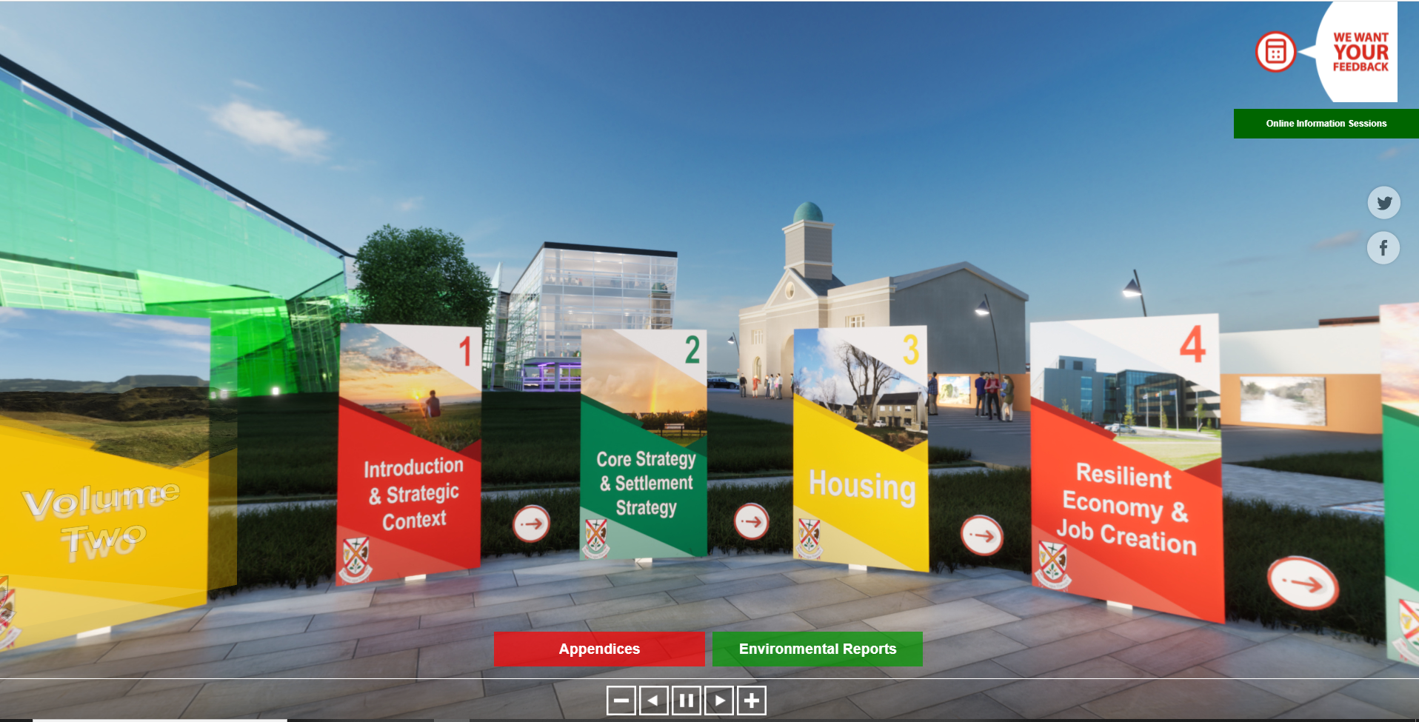
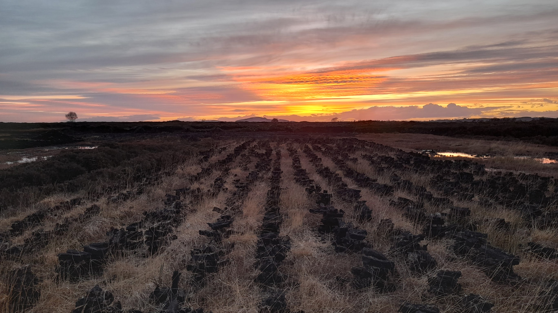
Public Consultation Strategy
Pre-Draft Public Consultation in Q1 2021
Draft Plan Public Consultation*
2 x public webinar events (statutory) (Attendants: 80)
Virtual Consultation Room
Photographic Competition (Entries: 306)
  Primary School Age
  Secondary School Age
Kildare County Development Plan Podcast Series
3 x online webinars/drop in meetings (non-statutory)
Social Media & Website Updates
Consultation Portal
Photographic Competition: 2nd Place - Under 12’s
Ruadhan Gorry – ‘Sunset over the bog’
* The Public Consultation Strategy has been “Public Health Restriction Proofed” in order to ensure a continuous & uninterrupted consultation

Slide 6
Points to note in considering the Draft CDP
Issues raised in submissions received at the predraft stage of the CDP (March 2021) have been considered in the Draft Plan, as are issues recorded at the online webinars hosted during the consultation.
The Proposed Draft Development Plan consists of 3 main parts:
Volume 1 (Written Statement)
17 Chapters
Volume 2 (Settlement Plans)
Small Towns (6), Environs (2), Rural Settlements (19) & Villages (17)
Appendices (12)
All areas are interlinked & should be read in combination.

Slide 7
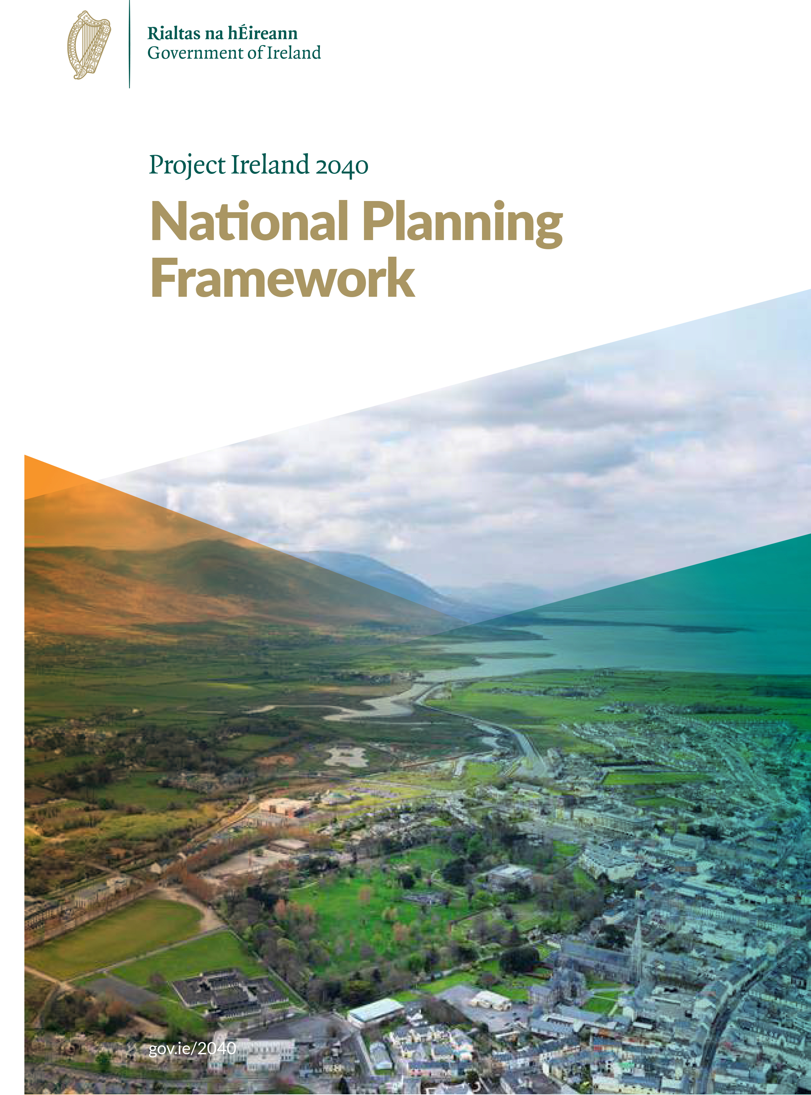
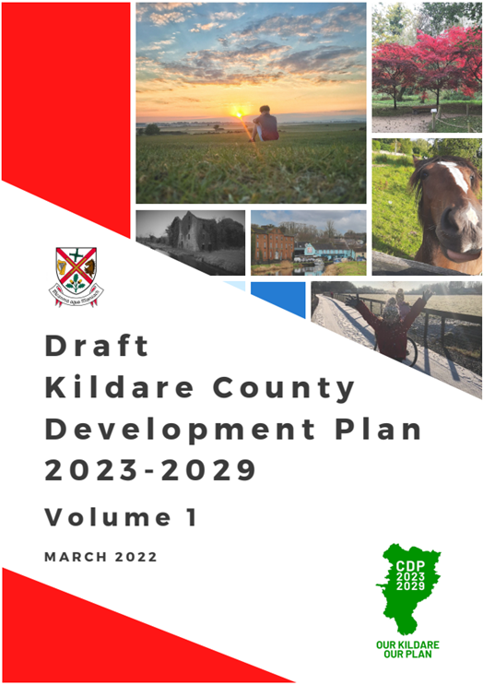
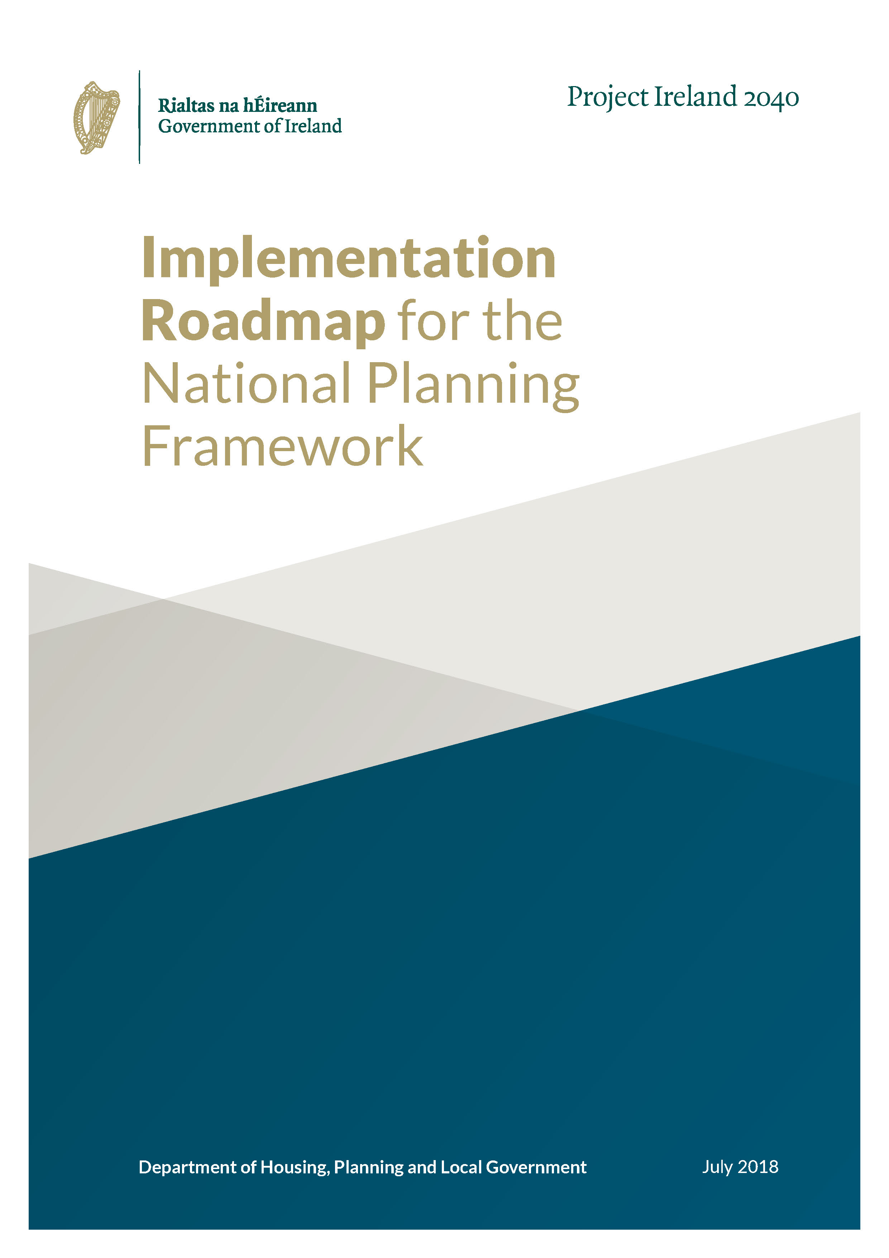
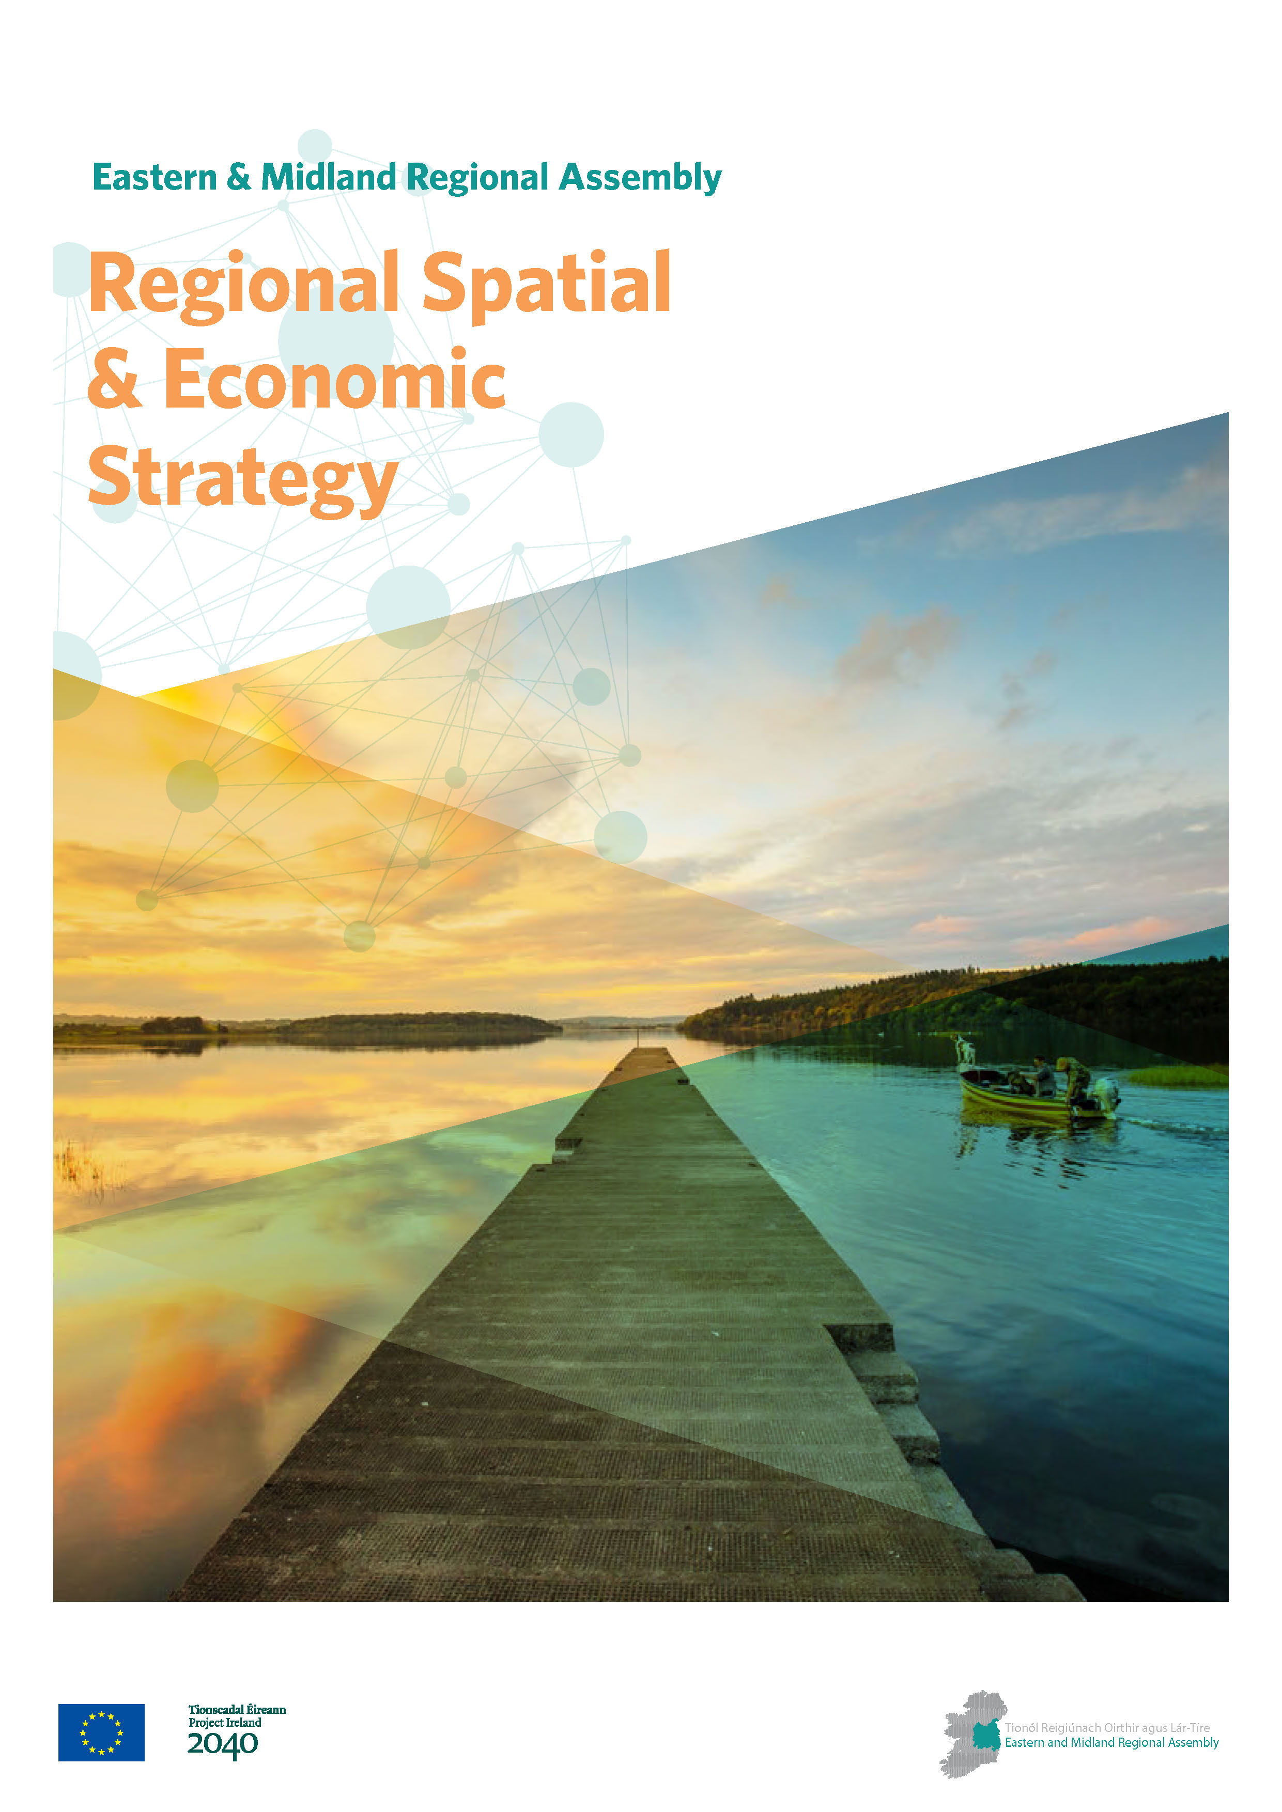
Spatial Planning Framework
National Planning Framework
NPF Roadmap
Informing
RSES
What We Must Consider…

Slide 8
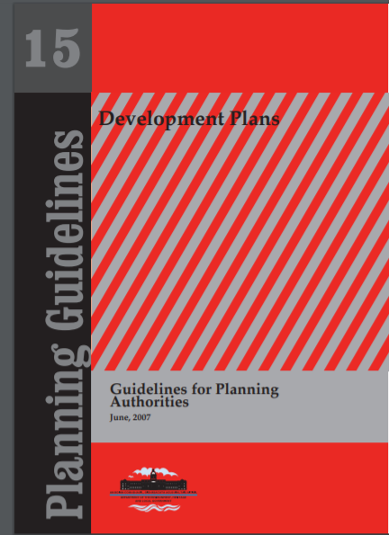
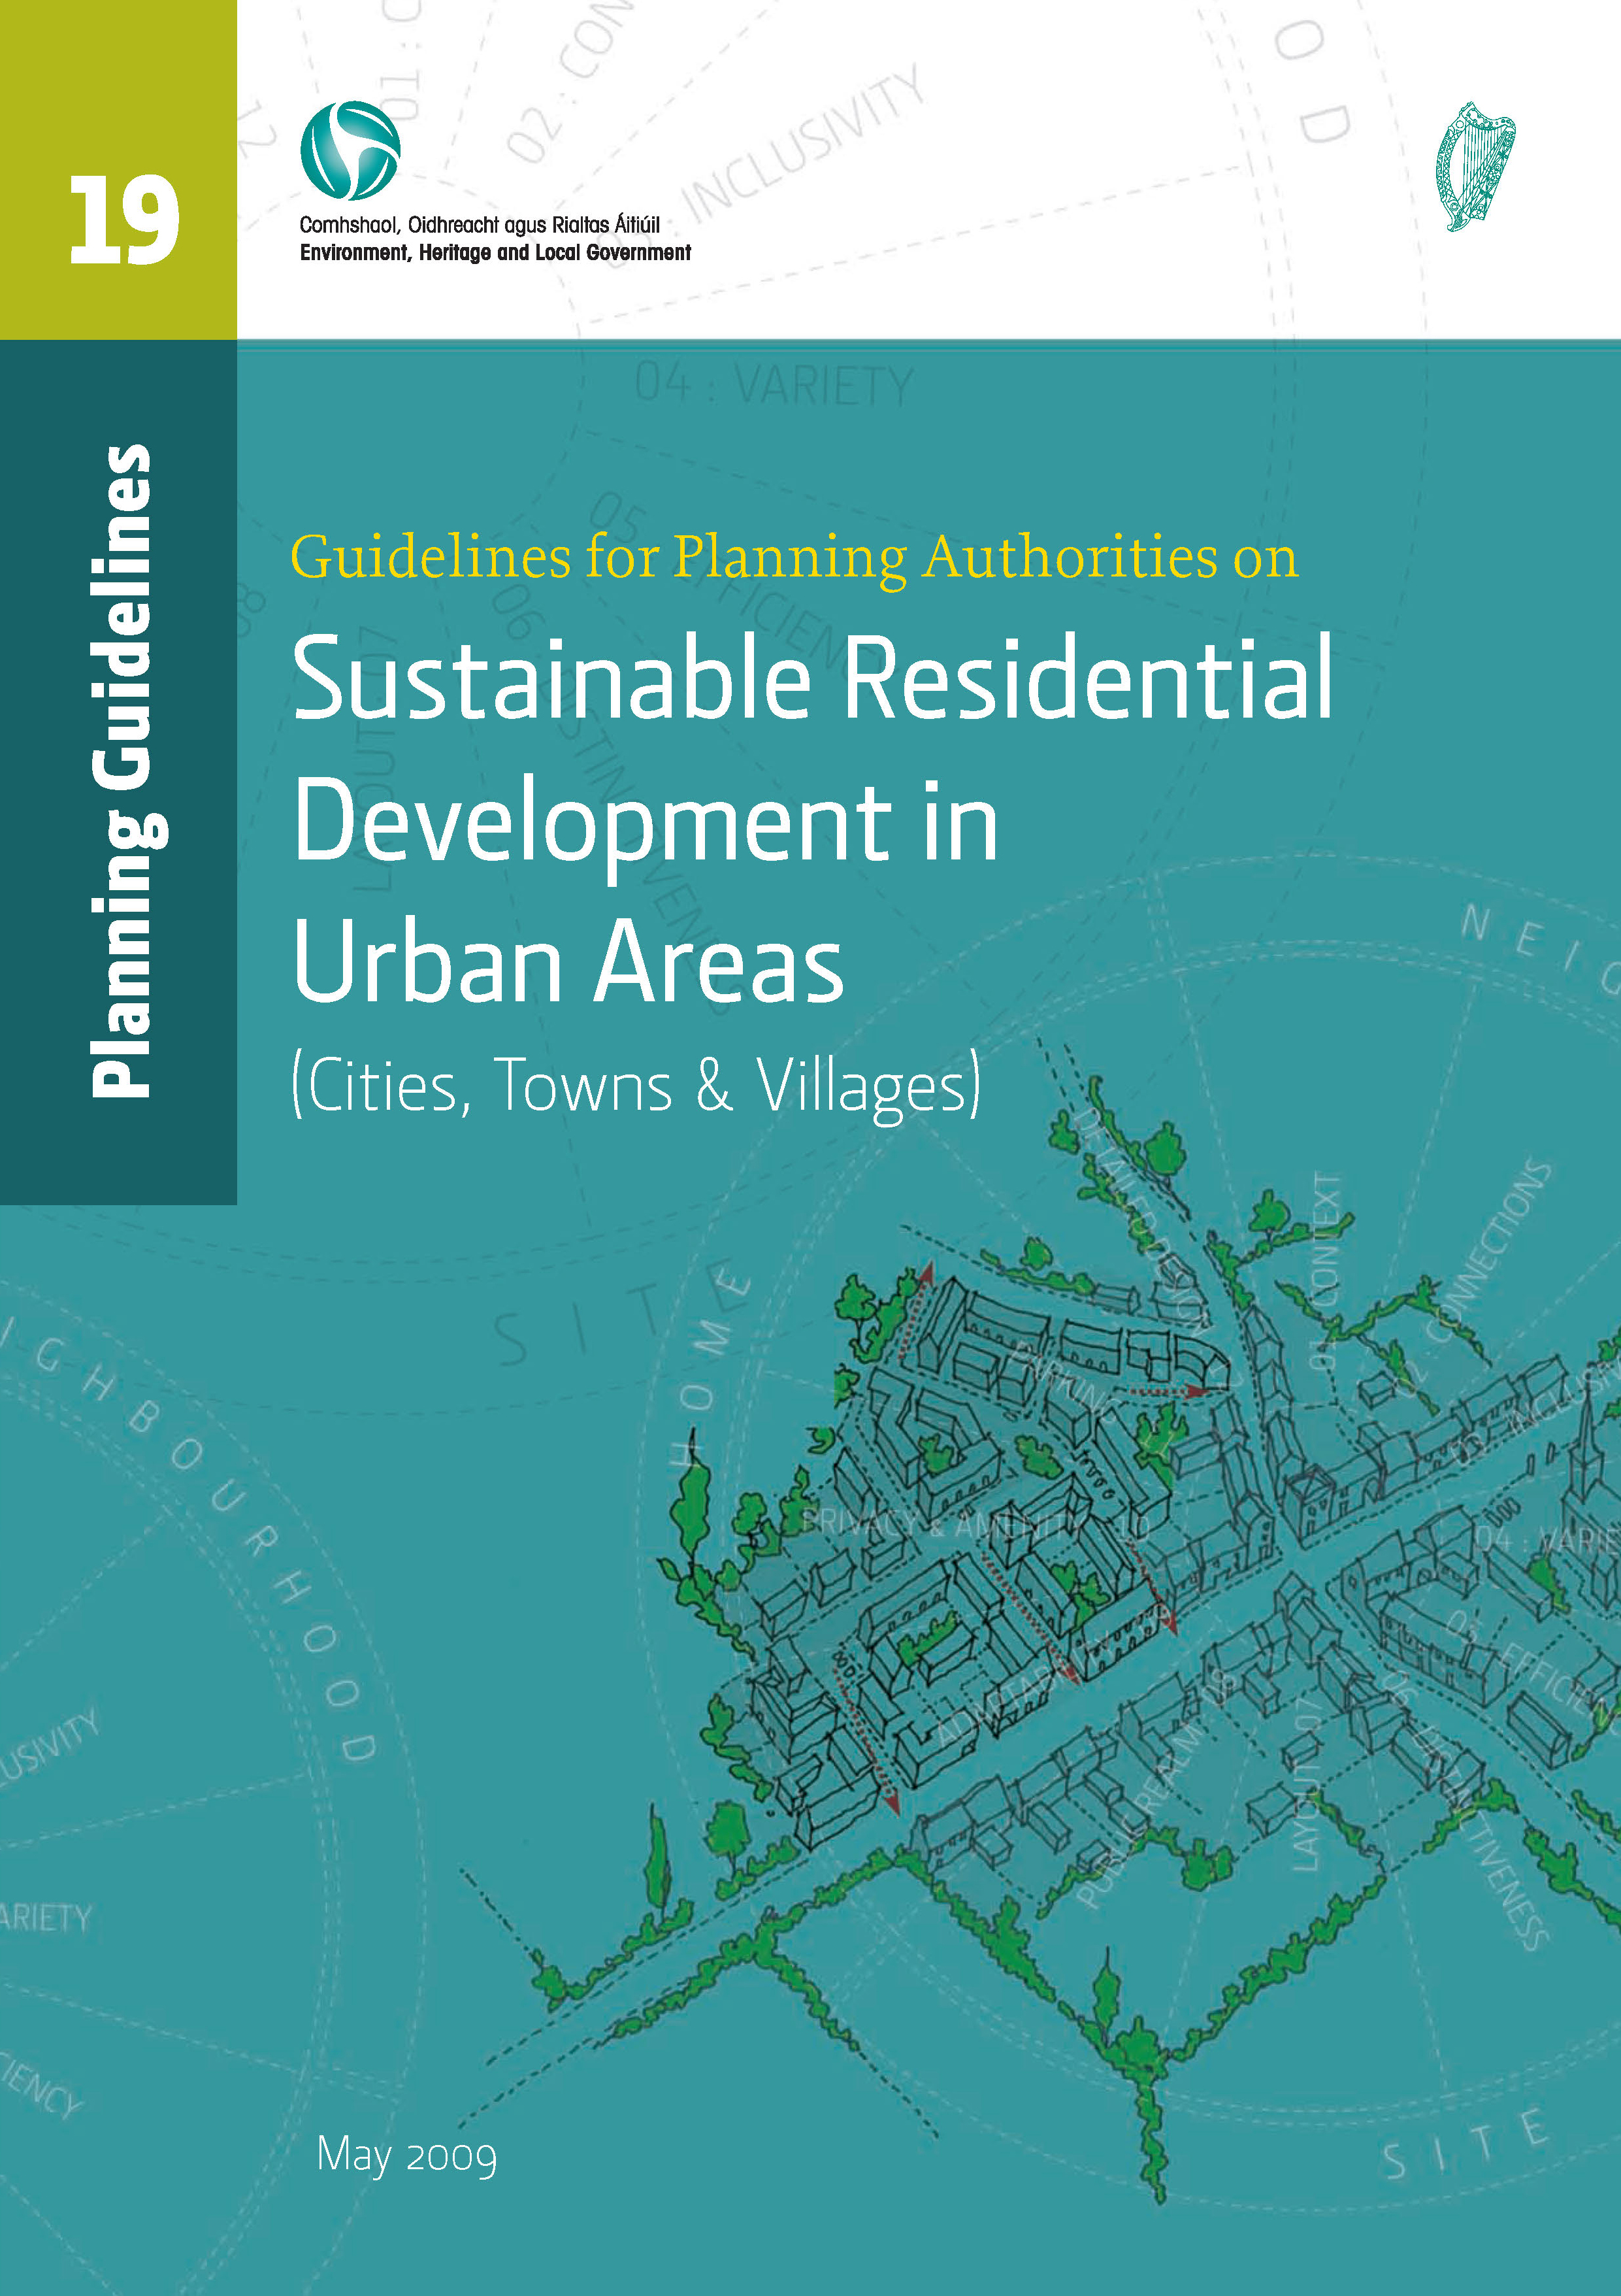
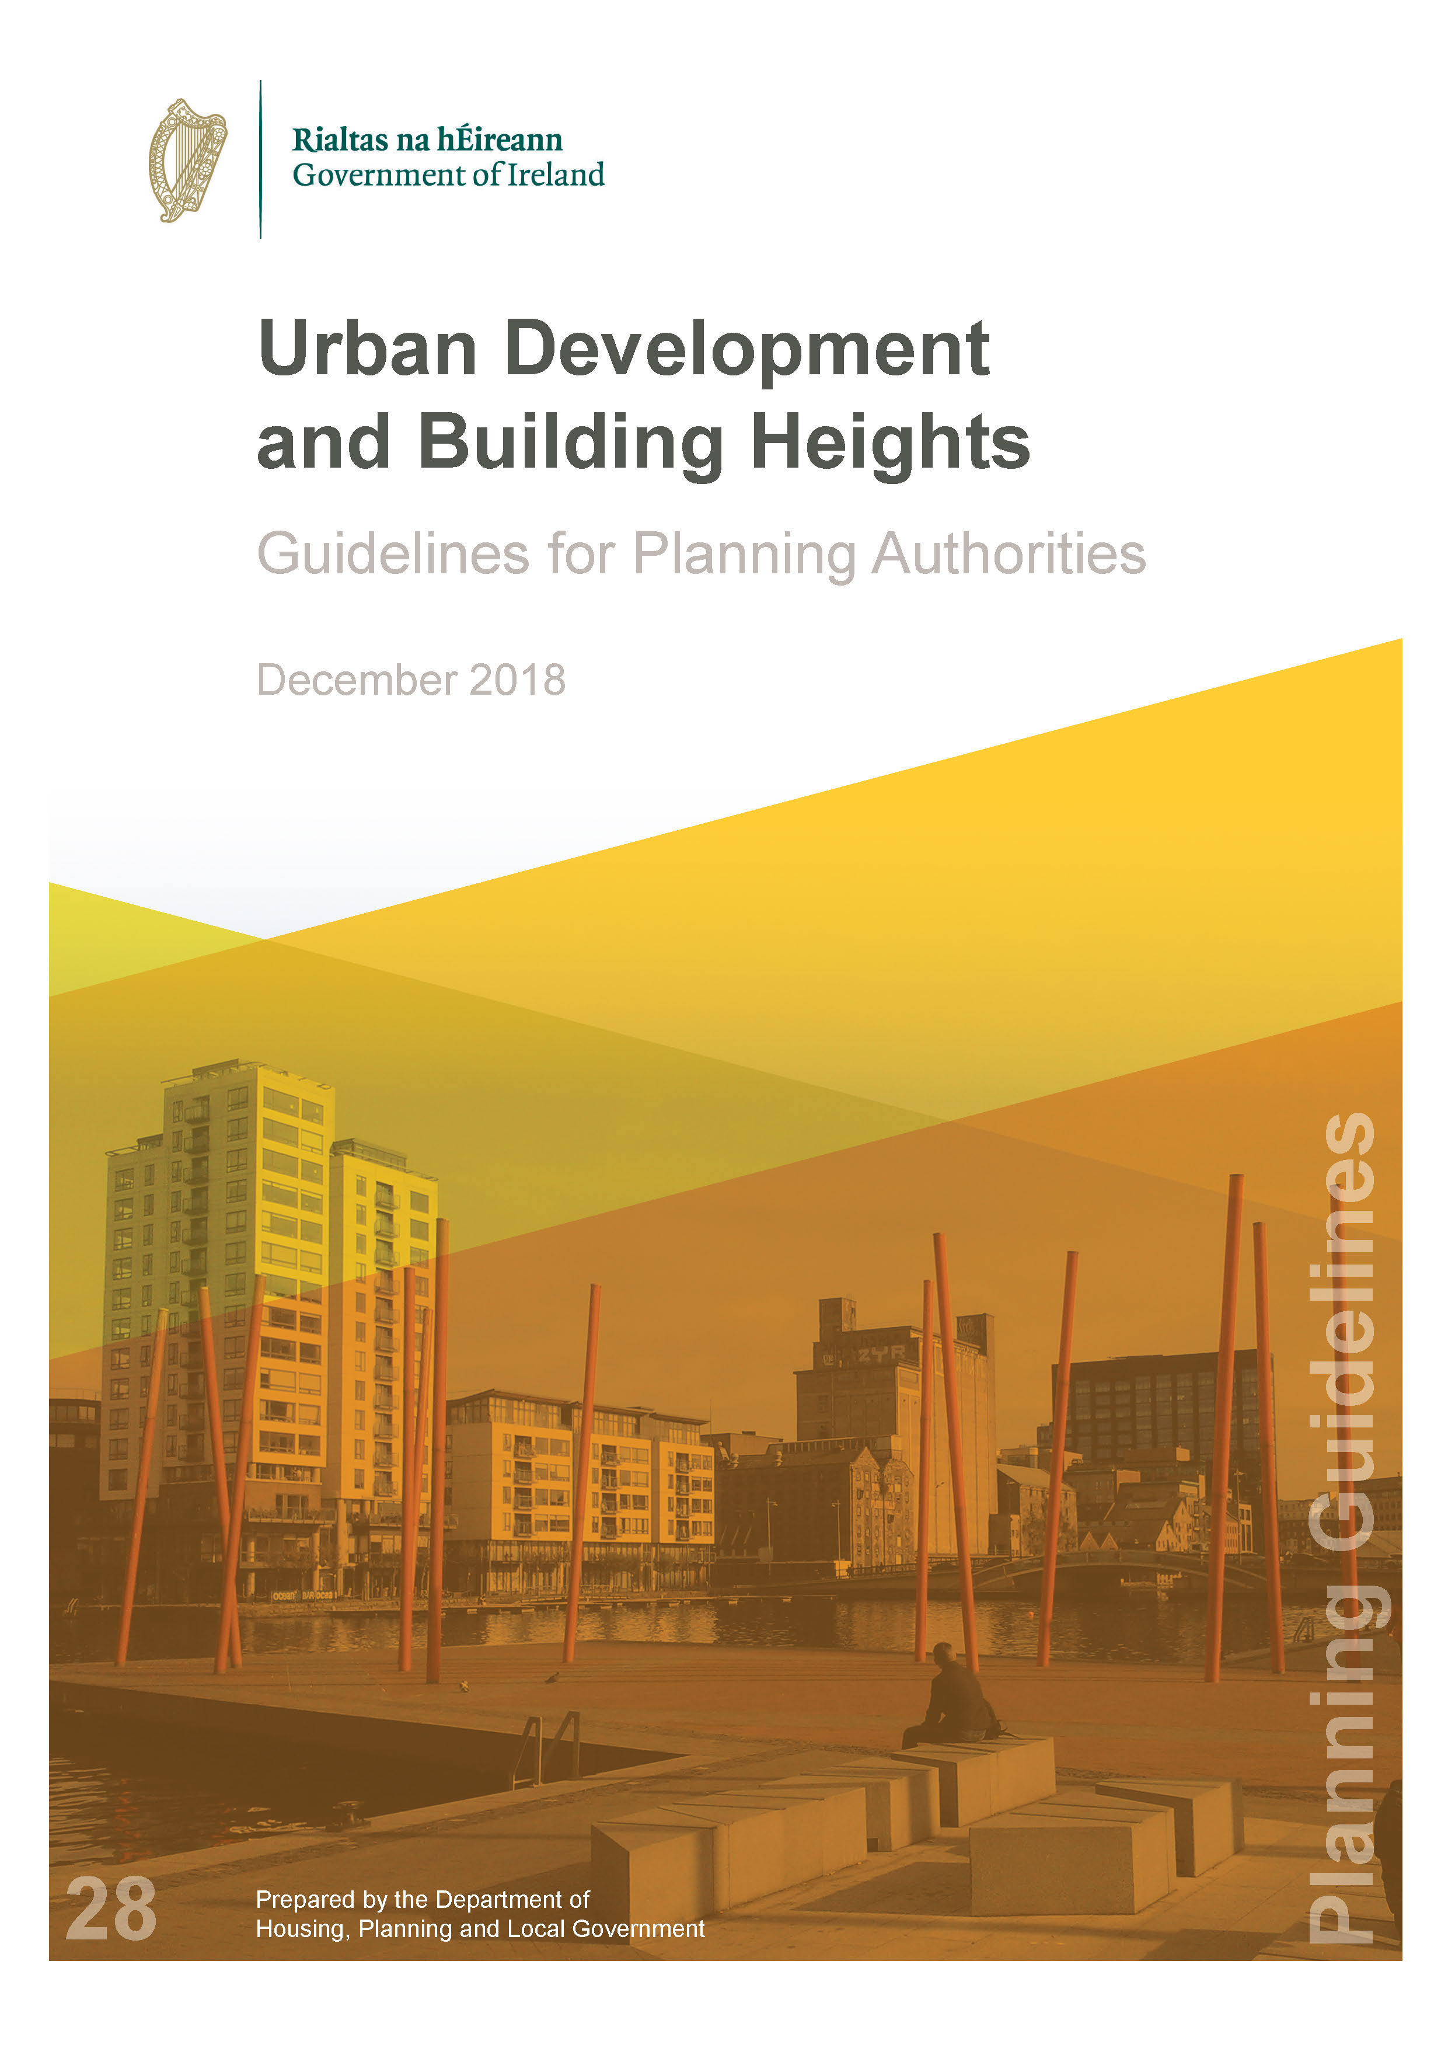
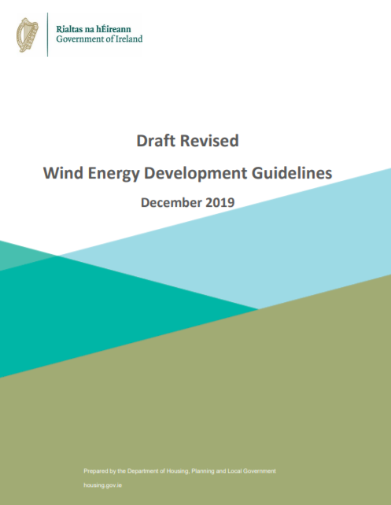
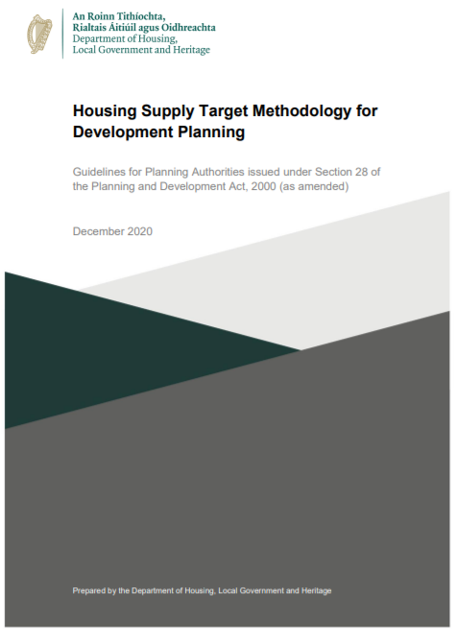
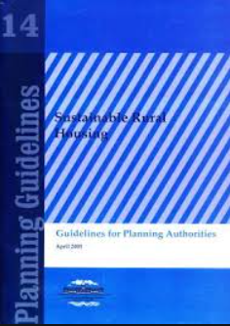
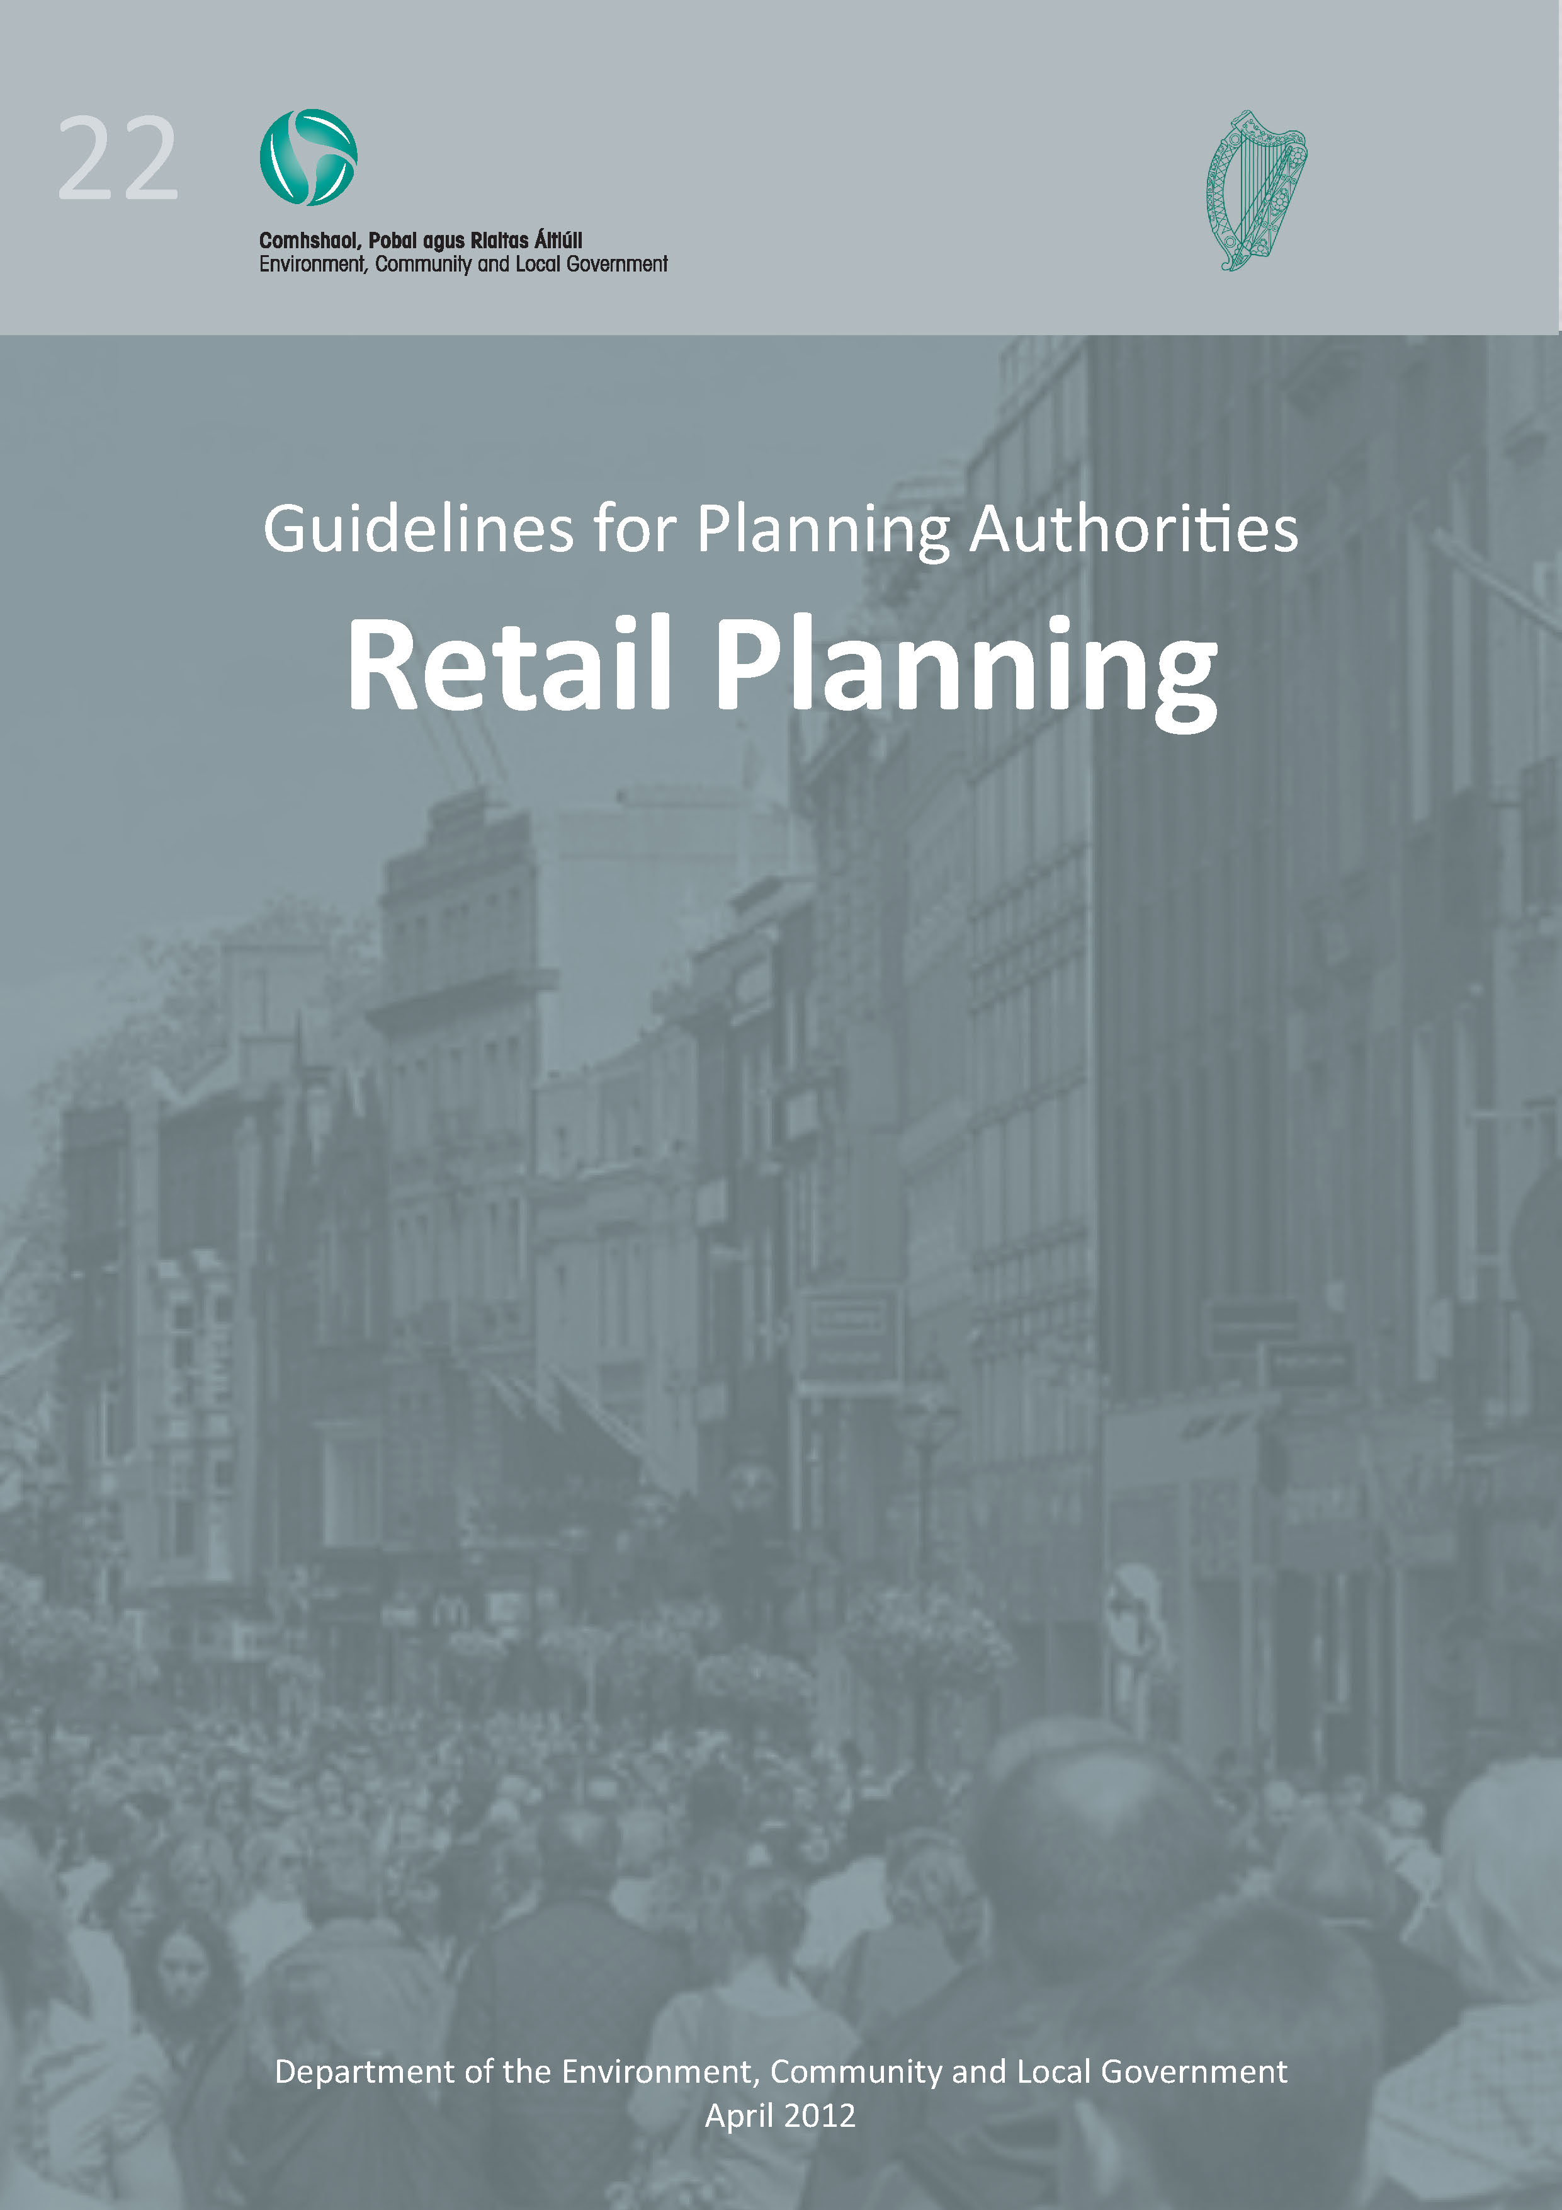
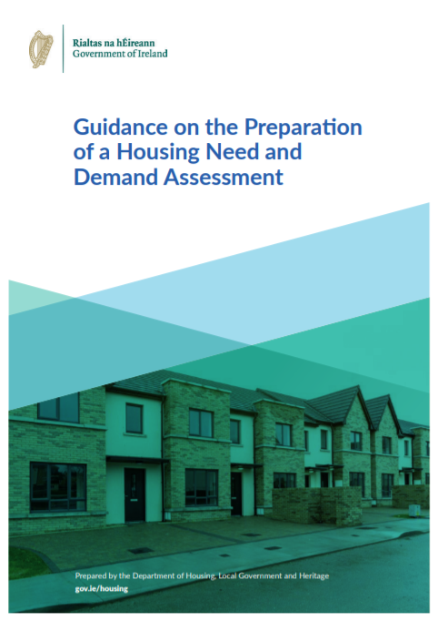
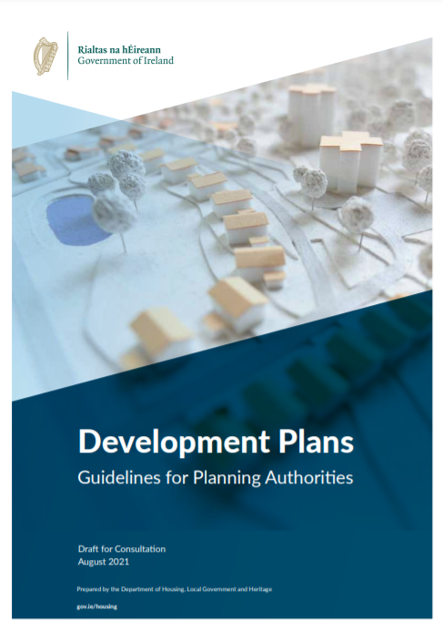
Guidelines for Planning Authorities (Section 28)
What We Must Consider…
*not exhaustive (See Appendix 8)

Slide 9
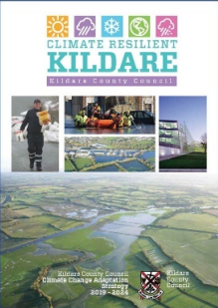
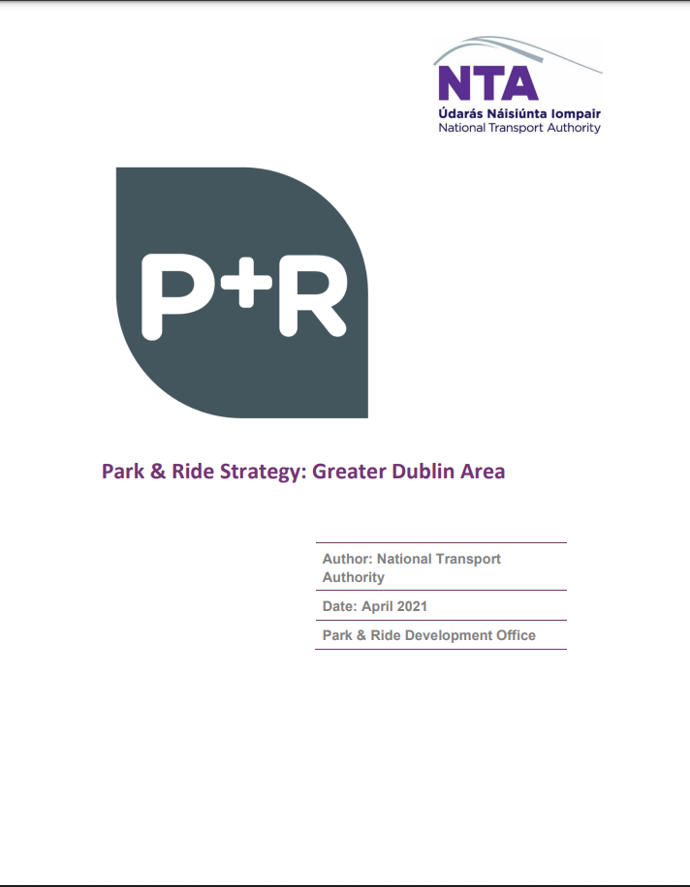
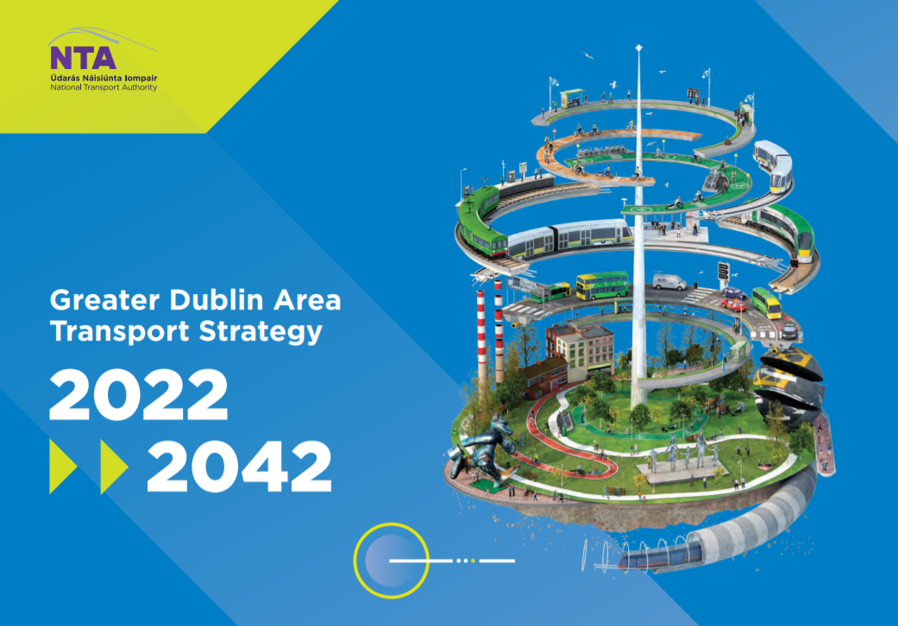

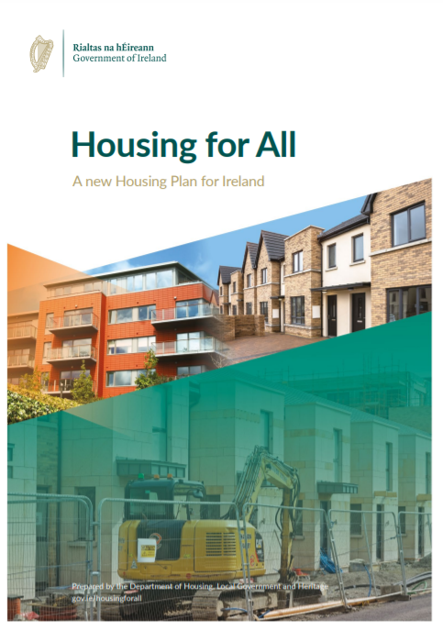
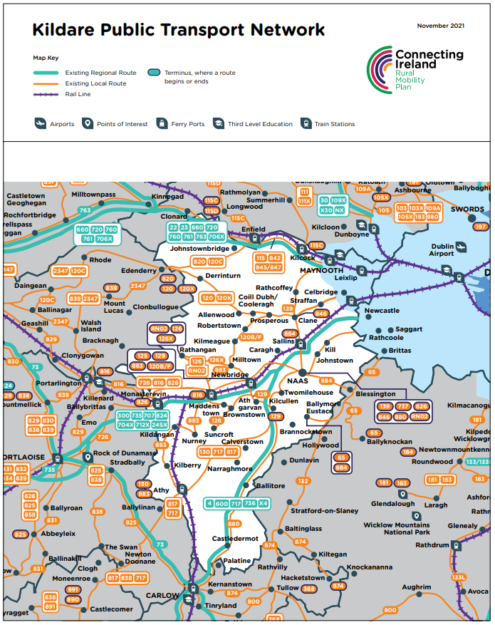
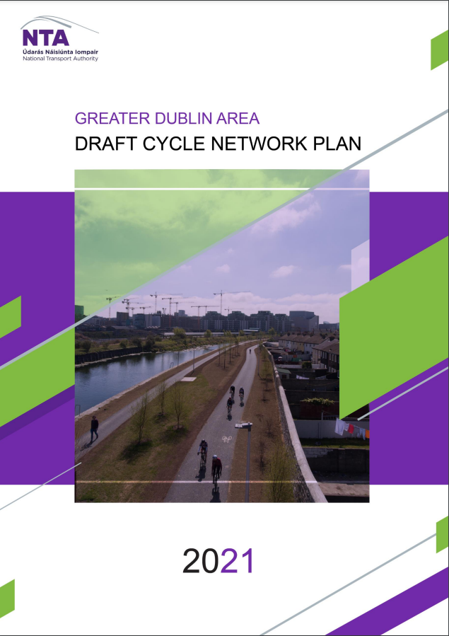
Other Policy Documents

Slide 10







Brief Overview of the dKCDP
The Draft Plan includes:
Policies
Objectives
Actions
Targets
164
1364
154
12
This presentation provides a snapshot of just a small sample of these policies, objectives, actions & targets under the following headings:
Core Strategy & County Kildare Housing Strategy
Community & Creative Places
Economic Development (including Rural) & Town Centres
Rural Housing
Small Towns & Villages (Volume 2)
Heritage, Biodiversity & Open Spaces
Energy Generation, Data Centres (inc. Wind) and Sustainable Mobility & Transport

Slide 11
Core Strategy for County Kildare
1. Achieving Critical mass in:
Metropolitan Area Strategic Plan (MASP) area:
Maynooth, Leixlip, Celbridge, Kilcock
Key Towns:
Naas and Maynooth
2. Measured growth with emphasis on economic growth:
Self-Sustaining Growth Towns:
Newbridge, Leixlip, Kildare Town, Athy
Self-Sustaining Towns:
Celbridge, Kilcock, Monasterevin, Clane

Slide 12






Core Strategy for County Kildare
Establishing a hierarchy of smaller rural settlements to develop rural centres capable of providing a range of services and employment to their local populations.
Managing development in rural areas with a focus on agricultural diversification, appropriate rural enterprise (e.g. renewable energy production) and the strengthening of existing towns and villages.
Protecting the environment by implementing an environmental protection policy which recognises the various environmentally sensitive zones within the county but not to mutually exclude appropriate and otherwise acceptable uses and development.
Providing a sustainable and viable alternative to one off housing in the open countryside for those who do not have a demonstrable economic or social need.

Slide 13

The Development Plans Guidelines for Planning Authorities are clear in stating that on devising the Core Strategy for its development plan, the planning authority must address both population and housing targets in a consistent and integrated manner:
Formulating the Core Strategy for County Kildare
Population: National and regional population targets and the projected population growth of cities, towns, villages and rural areas.
Housing: The proposed number of housing units to be included in the area to meet the housing supply target for the planning authority consistent with the prescribed methodology under the HST s.28 Guidelines.
The RSES sets out a settlement hierarchy defining the characteristics of each settlement typology. For County Kildare this translates to a hierarchy as follows;
Key Towns
Self Sustaining Growth Towns
Self Sustaining Towns
Towns
Villages
Rural Settlements
Rural Nodes/Rural Areas
COUNTY KILDARE
Naas & Maynooth
Newbridge, Leixlip, Kildare & Athy
Celbridge, Kilcock, Monasterevin & Clane
Castledermot, Derrinturn, Kilcullen, Kill, Prosperous, Rathangan, Sallins
Allenwood, Athgarvan, Ballitore, Ballymore Eustace, Caragh, Coill Dubh / Cooleragh, Crookstown,
Johnstown, Johnstownbridge, Kildangan, Kilmeague, Moone, Narraghmore, Robertstown, Straffan, Suncroft, Timolin.
Allen, Ardclough, Ballyshannon, Brannockstown, Broadford, Brownstown, Calverstown, Clogharinka, Cutbush, Kilberry, Kilkea, Kilmead, Kilteel, Maganey / Levistown, Milltown, Nurney, Rathcoffey, Staplestown, Two Mile House

Slide 14


While the CDP references the 2011-2016 intercensal period in terms of recent growth these do not determine future growth projections.
Core Strategy for County Kildare
The population growth & new housing distribution set out in the plan are based on:
Kildare allocation in the NPF/RSES
Housing Supply Target Methodology Guidelines from the DoHLGH
The calculations are based on actual housing delivery and the unmet housing demand in the county.
Step | Source | Calculation
1. | Housing demand 2020-2031² | 18,425
2. | CSO – dwelling completions for 2020 | 1,661³
 |  | = 16,764/11⁴
3. | Annual housing completion target for Kildare 2021- 2031⁵ | = 1,524 x 8⁶
 |  | = 12,192
4. | Housing completion estimates for 2021 and 2022 | - 3,048⁷
5. | CDP housing target to end of Plan period | = 9,144
The annual housing delivery average for County Kildare over the 9-year period between 2011 and 2020 is 882 units/year.

Slide 15
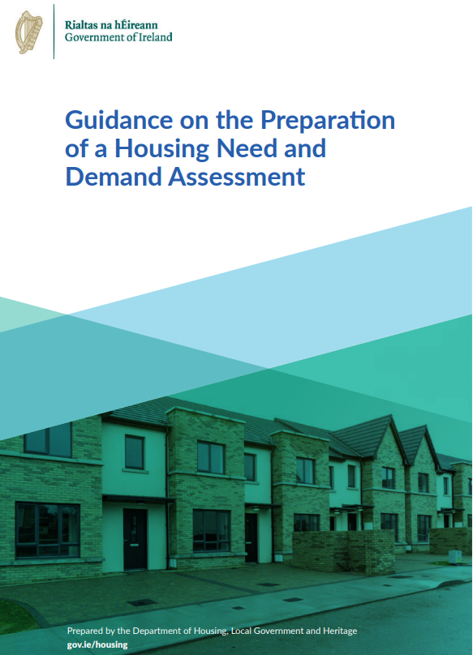
Housing Strategy & HNDA
Section 94(4)(a) of the Planning and Development Act 2000, now requires that a housing strategy include an estimate of the amount of:
i - Social housing
ii - Affordable housing
iii - Cost rental housing
Mandatory requirement under the Planning and Development Act 2000 (as amended).
Housing Need & Demand Assessment (HNDA) underpins and informs the housing strategy.
 | % Tenure Breakdown | Number of New Dwellings 2023-2031
New private ownership homes | 31.50% | 4360
New private rental homes | 27.70% | 3834
New affordable homes (Affordability Constraint) | 10.60% | 1467
New Social Housing homes | 30.20% | 4180
 | 100% | 13,840
These two outputs justify Kildare County Council applying the full 20% Part V requirement as policy, and a requirement for affordable housing of up to 10% of the overall 20% Part V requirement.
Notes:
The structure of HNDA is informed by the Guidance on the Preparation of a Housing Need and Demand Assessment, published by the Department of Housing, Local Government and Heritage in April 2021
The HNDA provides long-run estimates for housing need based on projected housing market affordability and finds that for the period 2023 to 2031, c. 30.2% of new households formed will need social housing support, 31.5% will be able to buy a home, 27.7% will be able to rent, and 10.6% will need affordable housing (affordable purchase or cost rental).

Slide 16


Regeneration, Compact Growth and Densification
Housing Chapter
Mix of Dwelling Types
Social, Affordable and Cost Rental Housing
Require that at least 30% of all new homes in settlements be delivered within the existing built-up footprint.
Require the submission of a ‘Statement of Housing Mix’ with all applications for 10 or more residential units.
The provision of a greater diversity of housing type and tenure, including social and affordable housing, new models of cost rental and affordable homeownership and co-operative housing.
Notes:
The Policies, Objectives and Actions contained in the Housing Chapter relates to:

Slide 17
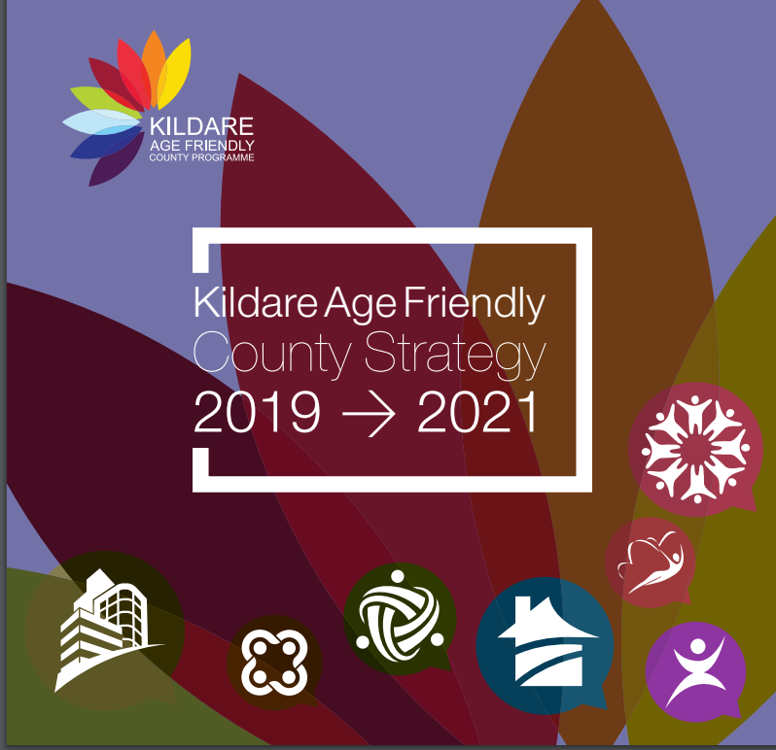
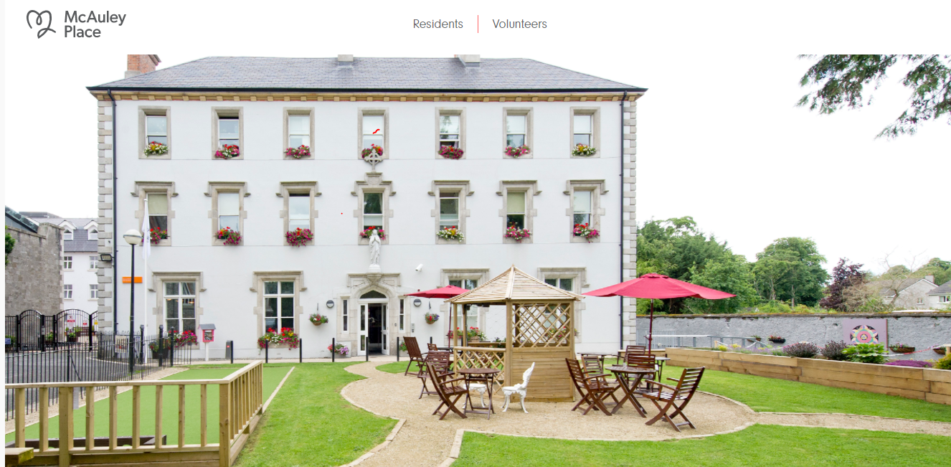

Specialist Provision (objectives relating to Older People & People with a Disability)
Support the implementation of the Kildare Age Friendly County Strategy 2019-2021 (and any subsequent strategy), promoting the delivery of Lifetime Homes and to support the provision of housing that is adaptable for an ageing population.
Promote McAuley Place, Naas, as a national exemplar model of housing for older people and seek to identify further opportunities for the Council (and other appropriate bodies) to expand this supported housing market.
Ensure and monitor that 10% of acquired housing stock meets the needs of those with a disability (dependent on market availability) and 12% of Kildare County Council new builds are suitable for those with a disability.

Slide 18









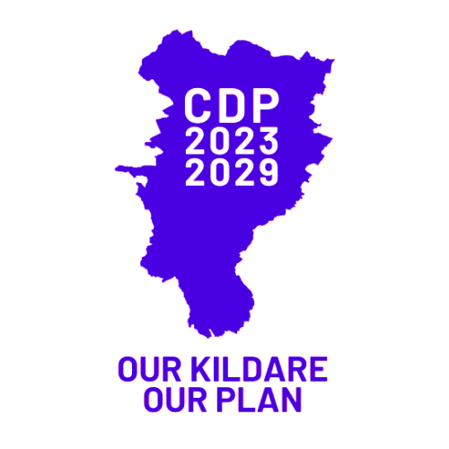
Economic Development
Future economic and enterprise development in Kildare should be largely distributed in accordance with the county’s economic hierarchy having regard to the individual areas
Identified role within the hierarchy
Existing size
Existing function
Capacity for sustainable growth
Available infrastructure capacity
There is, however, a positive presumption in terms of employment creation and therefore it is Council policy to examine such proposals within other locations on a case-by-case basis for example employment related development in a location clearly linked to a rural resource activity.
Notes:
Capacity for sustainable growth - (i.e. growth without detriment to its surroundings, its built or natural assets and/or its character)

Slide 19




Resilient Economy & Job Creation
Remote Working / Co-Working Spaces / Digital Hubs
Support remote working opportunities from designated hubs/ co-working spaces, in the interests of mitigating long commuting times.
SME
Small-Medium Enterprises (SMEs)
Actively promote and encourage the development of SME’s throughout the county, with a particular emphasis on locating these within the county’s towns and villages.
Knowledge Economy
Support an entrepreneurial environment to protect and enhance smart specialisations with a strong learning economy culture.
Green Circular Bio/Economy
Support the growth of business in the green and circular economy

Slide 20

Town Centres
Kildare County Council, is actively pursuing a programme of town and village renewal and is prioritising town centres as key destinations at the core of our economic and community life.
Town centres are crucial in realising the concept of compact growth and low carbon development in the county
Vibrant and Attractive Town Centres
Importance of Urban Design and the Creation of Sustainable Settlements
Urban Design
Higher Quality Public Realm
Climate Resilience
Strategic Open Space
Sustainable Mobility
Integrated Communities
Notes:
National and regional spatial policy has recognised that the traditional role of town centres has evolved, and will into the future, continue to change.

Slide 21
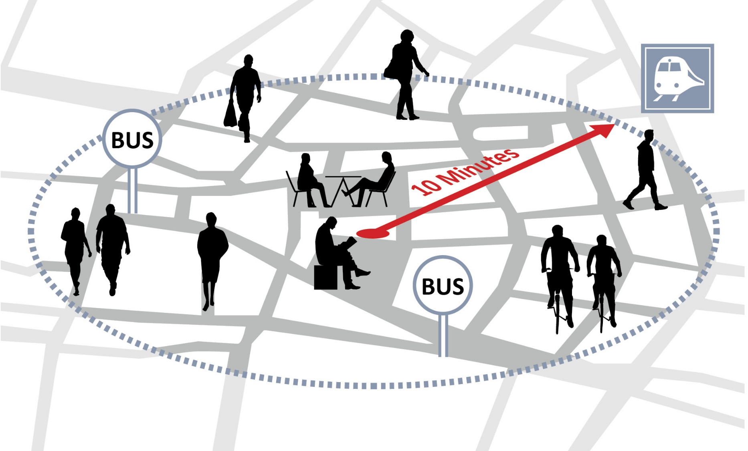
Healthy Placemaking Mechanisms
A high-quality public realm greatly assists in the development of a people-centred, universally accessible settlement
Chapter 14 of the Draft Plan outlines a range of placemaking strategies which the Council will employ to ensure that the principles of high-quality urban design are integrated into the planning and development process.
The 10-Minute Settlement Concept
The 10-minute settlement concept is a key aim of this Plan and seeks to have all community facilities and services accessible within a 10 minute walk or cycle from homes or to ensure that they are accessible by public transport services that connect to larger scaled settlements.

Slide 22



Tourism
Kildare currently has a varied tourism portfolio with a position of excellence in heritage, golf, equine including horse racing, adventure activities, shopping, walking and cycling (including the Greenways and Blueways).
Continue to work with Failte Ireland on the development of Ireland’s Ancient East, as well as the Destination Experience Development Plans and any smaller scale plans or programmes that have been prepared.
Facilitate and promote Kildare Town’s development as a National Tourism Hub, in conjunction with Failte Ireland.
Investigate the feasibility of developing a Tourism Destination Centre within the Curragh which would focus on the equine and military history of the area, in conjunction with Failte Ireland.

Slide 23





Barrow Blueway
Tourism
Peatland Tourism
Greenways
Support in conjunction with Offaly County Council and Laois County Council any proposal for a new National Peatlands Heritage Park on Bord Na Mona cutaway bogs in Kildare, Laois and Offaly.
Work with Waterways Ireland to progress the delivery of the (i) Naas to Sallins Greenway and (ii) Naas to Corbally Harbour Greenway and to develop the harbour itself for amenity purposes.
Support the development and marketing of the Barrow Blueway and facilitate related commercial opportunities throughout the county, subject to compliance with the Habitats Directive.

Slide 24


Agriculture
Rural Economy
Specific Industries that are relevant:
Agri – Food Sector
Kildare Food and Beverage Strategy 2021-2023 sets out the ambition to harness the strengths of the food landscape in the County and the actions needed to facilitate the growth of the sector in the throes of a Brexit and pandemic environment.
Recognise and support the importance of farming and agriculture in the County & continue to encourage the growth of part-time farmers.
Equine
Protect and nurture the environment which allows the equine industry to flourish in Co. Kildare.

Slide 25




Bogs & Peatlands
Rural Economy
Specific Industries that are relevant:
Mineral Resources & Extractive Industry
Forestry
Horticulture
The industry can have damaging environmental effects and permission will only be granted where the Council is satisfied that residential and natural amenities will be protected, pollution will be prevented, and aquifers and ground water are safeguarded.
Discourage monocultural forestry and encourage a greater range of tree species in forestry plantations and promote, in particular, more native, deciduous hardwood woodlands.
Encourage the re-wetting, restoring and/or re-wilding of former cutaway bogs and peatlands with an emphasis on promoting biodiversity and carbon sequestration.
Encourage the development of environmentally sustainable horticultural practices.
Notes:
The nature of the extractive industry is such that the industry must be developed where the resource occurs.

Slide 26


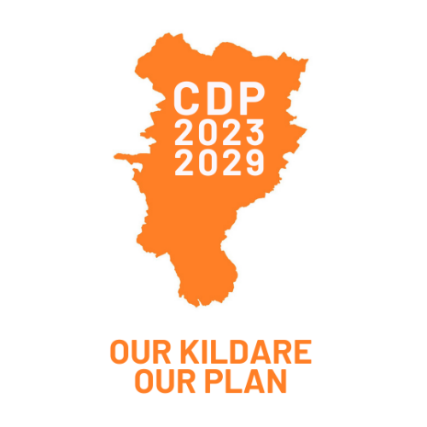
Biodiversity
Heritage, Biodiversity & Open Spaces
Heritage
Support the State in the nomination process of Dún Ailinne to World Heritage status as part of an assemblage of Royal and Monastic Sites in co-operation with the relevant Local Authorities.
Require, as part of the Development Management Process, the preparation of Ecological Impact Assessments that adequately assess the biodiversity resources within proposed development sites.

Slide 27
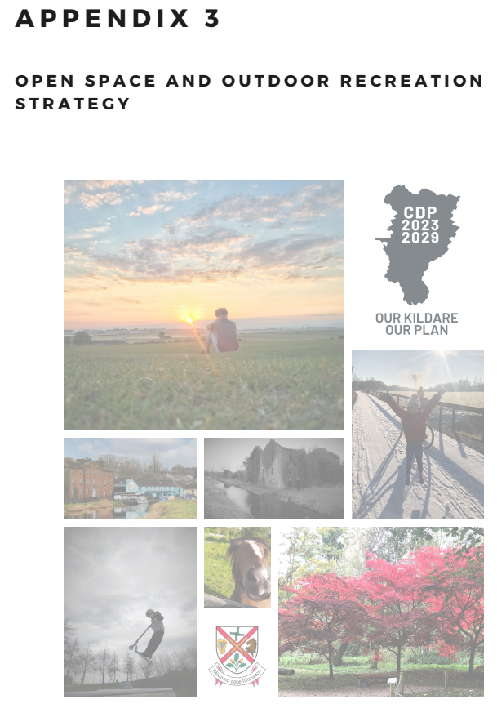



Open Space
Vision is to advance a network of accessible, inclusive and safe open spaces in order to sustain the recreational, environmental, health and well being needs of the community for current and future generations.
Recreation
Explore the provision of more recreational infrastructure at appropriate locations to include access ways and nature trails with a view to opening up state lands for recreational uses.
Support the extension and interconnection of Greenways, Blueways, Peatways and trails.
The Council will seek the provision of open space at a standard of 2.5 hectares per 1,000 population in accordance with the Kildare Open Space Strategy (2021)

Slide 28
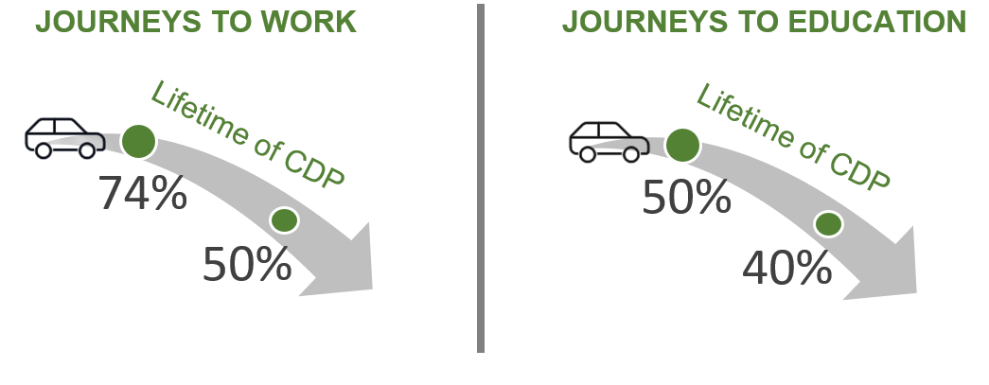



Modal Shift Targets
Sustainable Mobility & Transport
The RSES acknowledges that the transport sector is one of the main contributors to national Green House Gas (GHG) emissions and emphasises the importance of promoting a modal shift away from a dependence on the private car to more sustainable modes of transport, in order to facilitate greater efficiency in transport networks thereby addressing the impacts of climate change.
Notes:
The plan therefor identified targets to reduce car dependency…………………

Slide 29



Sustainable Mobility & Transport
A number of interventions are identified for the County which will assist in delivering the modal shift targets, such as the provision of walking & cycling infrastructure and public transport measures.
Facilitate and secure the delivery/implementation of the public transport projects within the Integrated Implementation Plan (2019-2024), including the DART+ programme and Bus Connects.
Facilitate and secure the delivery/implementation of the public transport regional corridor proposals and the local route proposals as identified within the NTA’s ‘The Connecting Ireland Rural Mobility Plan’ (November 2021).
Investigate the feasibility of developing high-quality, suitable, safe and sustainable cycling pathways:
from Leixlip, Maynooth and Naas into Dublin;
between Naas and Newbridge
Newbridge and Kildare town and westwards towards Portlaoise as far as the Kildare county boundary,
Kildare Town to Monasterevin.
Active Travel Funded Project

Slide 30

Key Road and Street Network
To facilitate future roads, cycle facilities and other transport infrastructure improvement identified within this Plan (Table 5.4 & Table 5.5) and Local Area Plans.
Celbridge Second Bridge and link road scheme, including new pedestrian and cycling infrastructure.
Second bridge crossing in Newbridge
Active Travel Funded Project
Support and facilitate Orbital Movement in Leinster.
Measure ROAD6
Catering for Orbital Movement in Leinster
Draft GDA Transport Strategy
Support and facilitate enhanced orbital movement between the N3, the N4 and N7 national roads.
Measure ROAD9 –
Regional and Local Roads Policy
Draft GDA Transport Strategy
Supply and Management of Parking
Car parking limits will be considered on an area wide basis, where appropriate, in locations where the highest density of development occurs.
Notes:
According to the NTA Draft Transport Strategy for the Greater Dublin Area 2022-2042, the supply and management of parking at destinations is central to the management of travel demand. Limiting the availability of parking spaces and/or increasing the cost of parking will encourage the use of sustainable modes of transport and reduce traffic congestion.

Slide 31
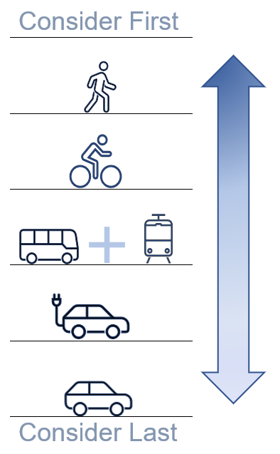
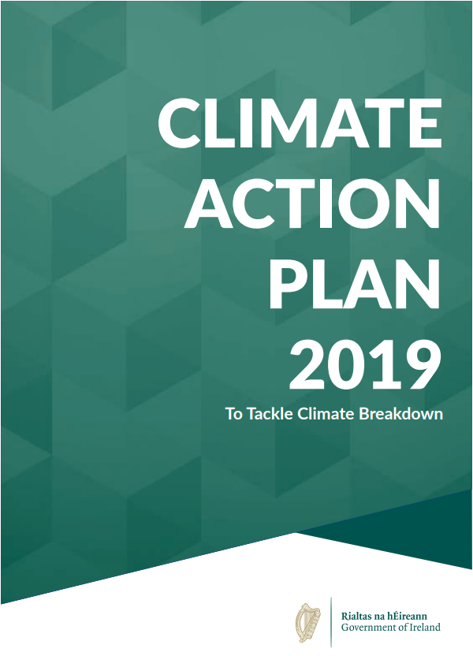
Electric Vehicles
Committed to a target of 936,000 electric vehicles on Irish roads by 2030.
Ensure a future proofed approach to the rollout of EV charging infrastructure by means of planning decisions by applying requirements to all new buildings or buildings undergoing major renovations.
Requirements of the EU (Energy Performance of Buildings) Regulations 2021 (S.I. 393 2021) for Electric Vehicle recharging infrastructure
Notes:
Design Manual for Urban Roads and Streets outlines a user hierarchy to consider during the design of roads and streets which prioritises sustainable forms of transportation.
To recognise the importance of electric vehicles in reducing Greenhouse Gas emissions, Kildare County Council will add electric vehicles to the hierarchy to be considered before private motor vehicles.
The plan identified various objectives to support the target such as…

Slide 32
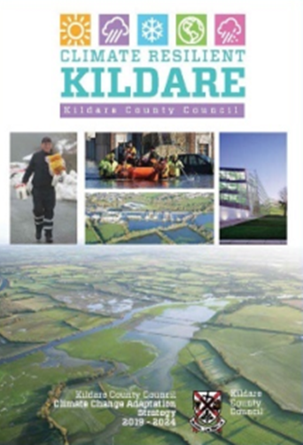

Energy Generation, Data Centres (inc. Wind Energy)
County Kildare Climate Change Adaptation Strategy, 2019
Takes on the role as the primary instrument at local level to:
  Ensure a proper comprehension of the key risks and vulnerabilities of climate change;
  Bring forward the implementation of climate resilient actions in a planned and proactive manner;
  Ensure that climate adaptation considerations are mainstreamed into all plans and policies and integrated into all operations and functions of Kildare County Council.
Climate Action Plan, 2019
Government’s approach, aimed at enabling Ireland to meet its EU targets to reduce carbon emissions by 30 percent between 2021 and 2030 and layhe foundations for achieving net zero carbon emissions by 2050.
Key Action of this Plan
Prepare, within 1 year of the adoption of the County Development Plan a Sustainable Energy Climate Action Plan (SECAP) for County Kildare.
Key Objective of this Plan
To support the establishment of a Mid-East Energy Bureau in collaboration with Wicklow County Council, Meath County Council and the Sustainable Energy Authority of Ireland.
Notes:
One of the Key Actions identified in this Chapter is to….

Slide 33
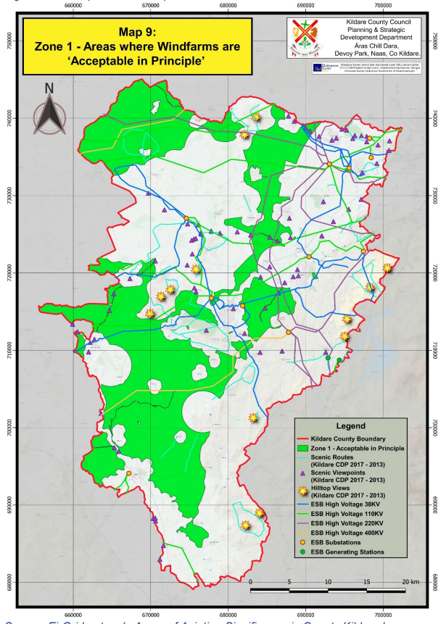
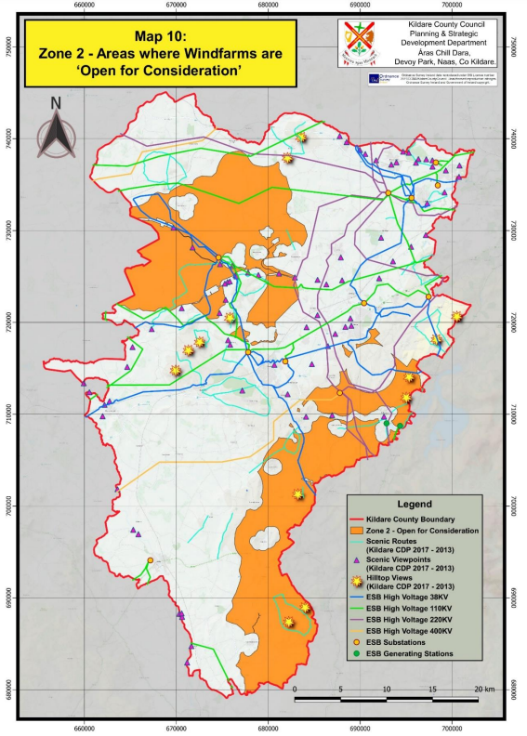
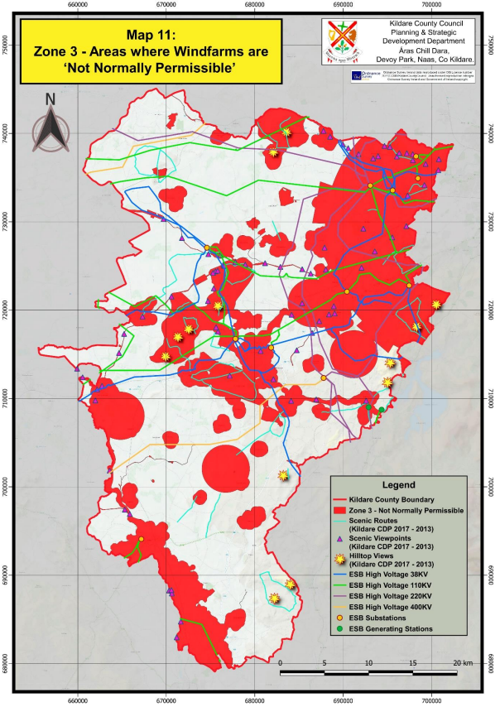
Wind Energy Strategy
A Wind Energy Strategy is presented in Appendix 2 of this Plan.
The wind energy target for Kildare is 107MW to the end of this Plan period, taking account of the permitted wind farm developments and wind energy proposals that have yet to come forward to planning stage and be constructed by the end of the Plan period in 2029.
Notes:
The Wind Energy Strategy designates areas across the county where wind energy developments are acceptable in principle, open for consideration and not normally permissible.

Slide 34


Renewable Energy
Renewable Energy
Support the roll-out of the Smart Grids and Smart Cities Action Plan.
Support and encourage the production of energy primarily for on-site usage.
Encourage developers of proposed large scale renewable energy projects to carry out community consultation.
Ensure that whenever possible and appropriate, community benefits are derived from all renewable energy developments in the county
Prepare and implement an overall Renewable Energy Strategy for the County.
Support the roll out of the Renewable Electricity Support Scheme (RESS).
Solar & Wind Energy
Encourage and support the use of appropriately scaled solar energy in residential, commercial and industrial developments.
Require decommissioning and site rehabilitation plans as part of any solar or wind farm development application.
Notes:
One of the Key Actions of this Chapter is to….

Slide 35
Energy Generation, Data Centres
Hydro Energy
Support proposals for hydro energy installations
Micro Renewable Energy
Facilitate micro-renewable energy installations and auto-generator installations.
Geo-Thermal Energy
Facilitate large and smaller scale geothermal energy generating developments.
Low Carbon District Heating
Where data centre developments are approved, the Council will expect district heating systems to be developed for adjoining residential, community and/or commercial developments.
Carry out a feasibility assessment for district heating in County Kildare.
Bio-Energy
Support the location of biomass installations.
Support and promote domestic biological treatment.
Energy from Waste
Promote the circular economy in terms of waste planning and management by promoting the development of local biodigesters subject to the prior grant of an Industrial Emissions License from the EPA.
Data Centres
The Council is mindful that Data Centres should avoid sensitive landscapes and environments.
Any application for a data centre shall take account of the cumulative visual impact.
Require data centres to consider the use of renewable sources of energy to fuel their operations.
Strategic Energy Zones
Identify Strategic Energy Zones in conjunction with EMRA

Slide 36
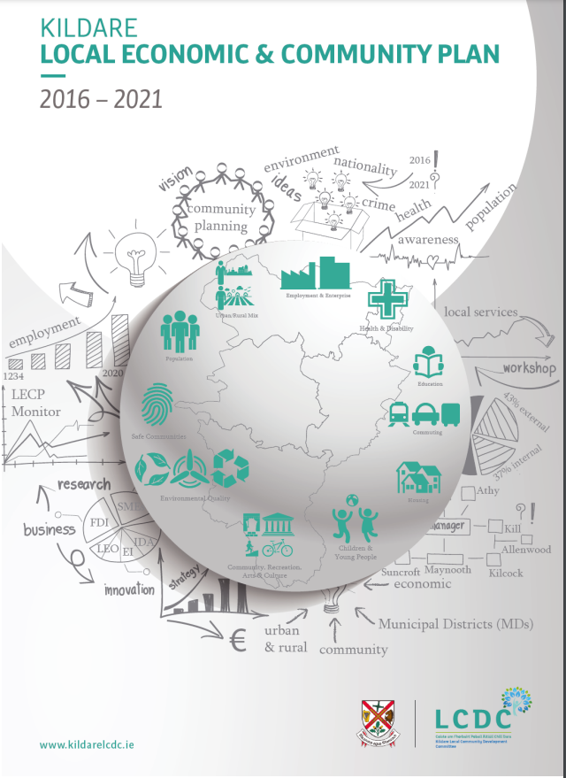



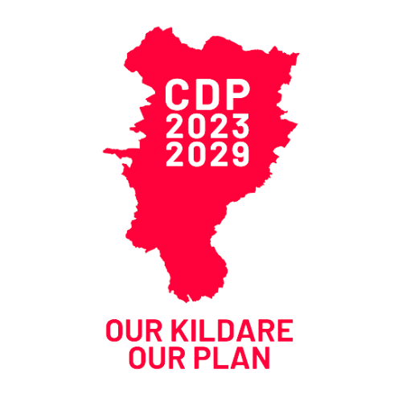
Community, Leisure & Cultural Services and Facilities
Community & Creative Places
The Kildare LECP 2016-2021 was adopted in December 2015. While the LECP provides the framework for economic development and local community development, the County Development Plan provides the spatial strategy for the realisation of these objectives and actions.
Protect and enhance existing social infrastructure/community facilities and increase the provision as required.
Social Inclusion and Spatial Justice
Promote social inclusion and spatial justice through equality of access to services and facilities and assist in the removal of barriers to full participation in society.
Arts and Culture in the Community
Develop and improve the physical infrastructure of arts and cultural facilities throughout the county particularly in areas where there is a deficiency in such provision.

Slide 37



Educational Facilities
Community & Creative Places
Support the Department of Education’s School Building Programme by actively identifying sites.
Childcare Facilities
Ensure childcare provision is delivered in new communities prior to or in tandem with phase 1 of any residential or commercial development and is fully operational prior to the occupation of any residential units within the subject site.
Health Services
Support the Health Service Executive (HSE) and other statutory and voluntary agencies in the provision of appropriate healthcare facilities, including the system of hospital care and the provision of community based primary care facilities appropriate to the size and scale of each settlement.

Slide 38










Community & Creative Places
Groups with Specific Design/Planning Needs:
Children and Young People
Older People
People with Disabilities
Traveller Community
Ethnic Minority Groups
Facilitate the provision of continuing care facilities for the elderly, such as own homes (designed to meet the needs of elderly people), sheltered housing, day-care facilities, nursing homes and specialised care units (e.g. dementia specific units) at appropriate locations throughout the county.

Slide 39
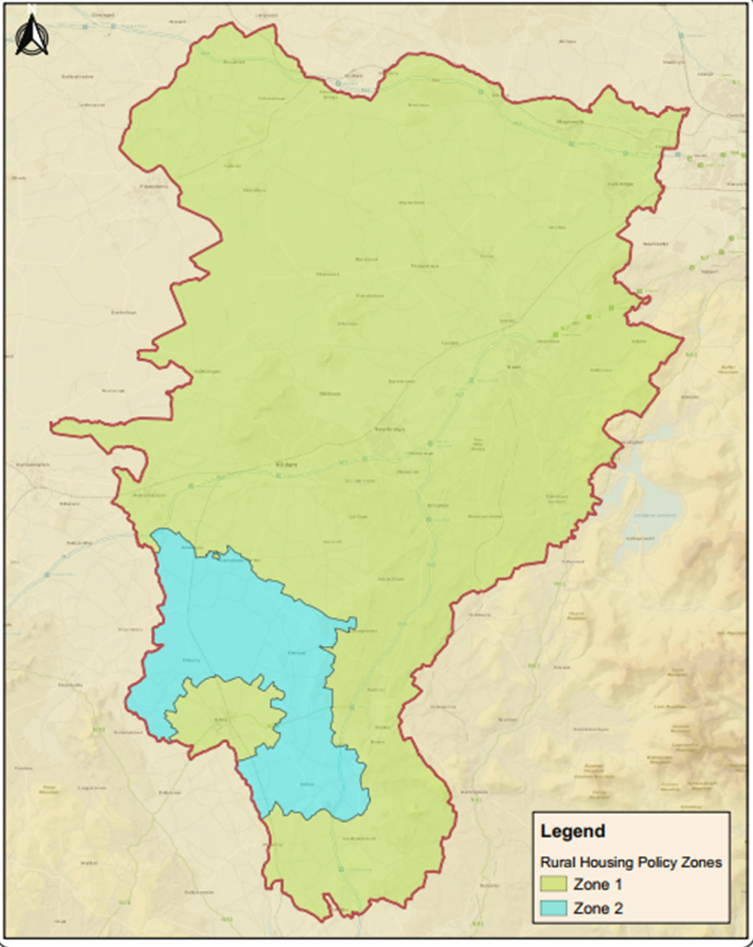

Rural Housing
Zones
Zone 1
Areas under Strong Urban Influence
Zone 2
‘Stronger Rural Areas’
Demonstrable ‘economic or social’ need to live in a rural area and build their first home.
Siting, environmental and design criteria for rural housing in statutory guidelines and plans.
Have regard to the viability of smaller towns and rural settlements.
Provision and availability of serviced sites in these areas.
Areas of significant scenic value which must be protected to maintain and protect their landscape quality.
Notes:
Facilitate the provision of single housing in the countryside based on the core considerations of:

Slide 40

Sustainable Alternatives to Rural Housing
Aligned with NPO 18b of the NPF
It is envisaged that the “County Kildare Serviced Sites Initiative” will accommodate existing and attract new residents to live in our villages and sustain communities and economies.
The provision of serviced sites to create ‘build your own home’ opportunities within the existing footprint of settlements will provide a sustainable alternative to one-off housing in the countryside.
Lands identified for “Serviced Sites” should be within or immediately adjacent to existing settlement envelopes & may in some cases represent infill or consolidation of villages/settlements
Note: Lands identified as “SE- Settlement Expansion” or “C- New Residential” will also be considered for Serviced Sites where the required services are available

Slide 41
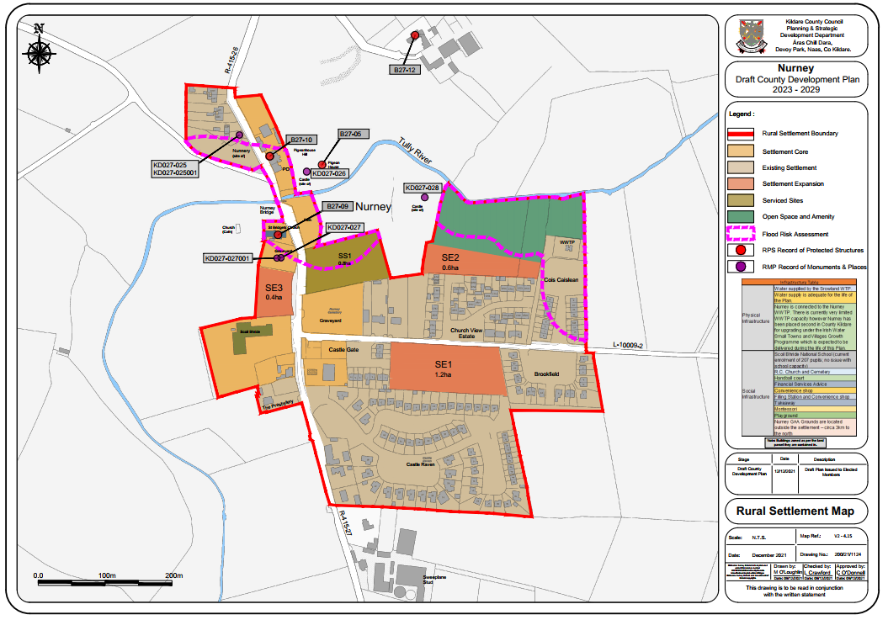



Volume 2 – Small Towns & Villages Strategy
The NPF highlights that rural living requires a proportionate and tailored approach to residential development to ensure that a suburban or high-density urban approach is not applied to a rural setting and that development responds to the character, scale and density of the town.
(Appendix 4 of this Plan provides guidance with respect to how serviced sites could be developed).
Development proposals for lands within the settlements outlined with a broken pink dashed line will be subject to site-specific Flood Risk Assessment appropriate to the type and scale of the development being proposed.
Notes:
Specific locations within the various settlements have been identified, where serviced sites may be accommodated.

Slide 42
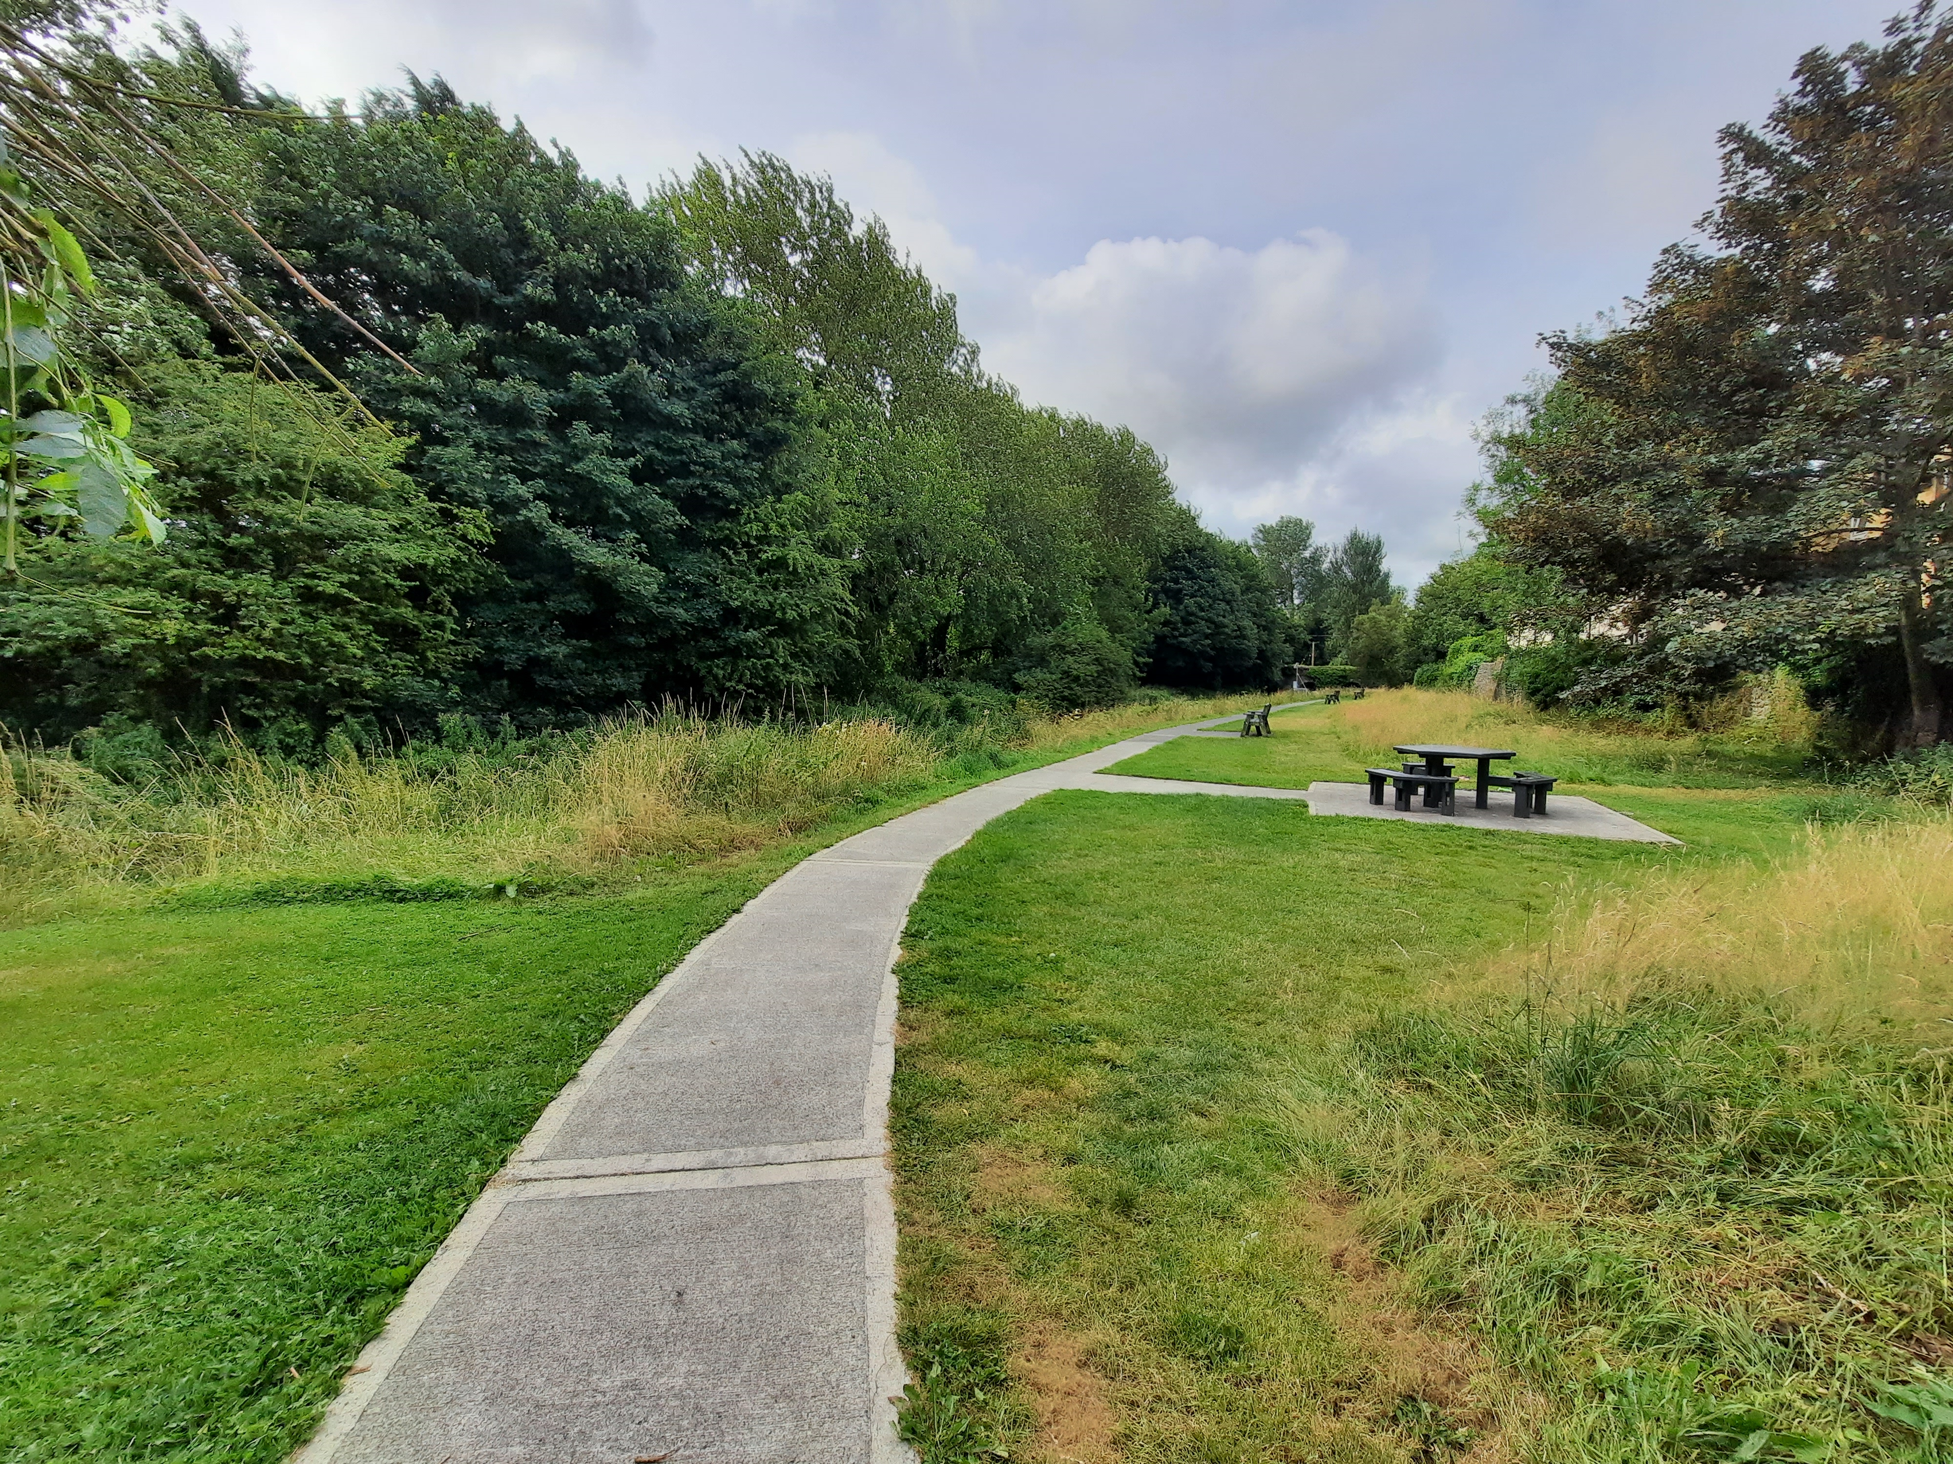
Small Towns
Castledermot, Derrinturn, Kilcullen, Kill, Prosperous, Rathangan, Sallins
Sallins
Kilcullen
………recorded populations in the 2016 Census which triggers a legislative requirement for a Local Area Plan.
Rathangan
Towns | Housing Target 2023 to 2028 (end of Q4) (units) in accordance with HSTGs | Residential Zoned Land Requirement (ha) | Target Residential Density (UPH
Castledermot | 46 | 2 | 30-35
Derrinturn | 55 | 2 | 30-35
Kill | 119 | 3 | 35-40
Prosperous | 91 | 3 | 35-40
Rathangan | 82 | 3 | 35-40
Each small town plan contained in Volume 2 has associated zoning objectives which relate to the land use zoning matrix of the Plan.

Slide 43
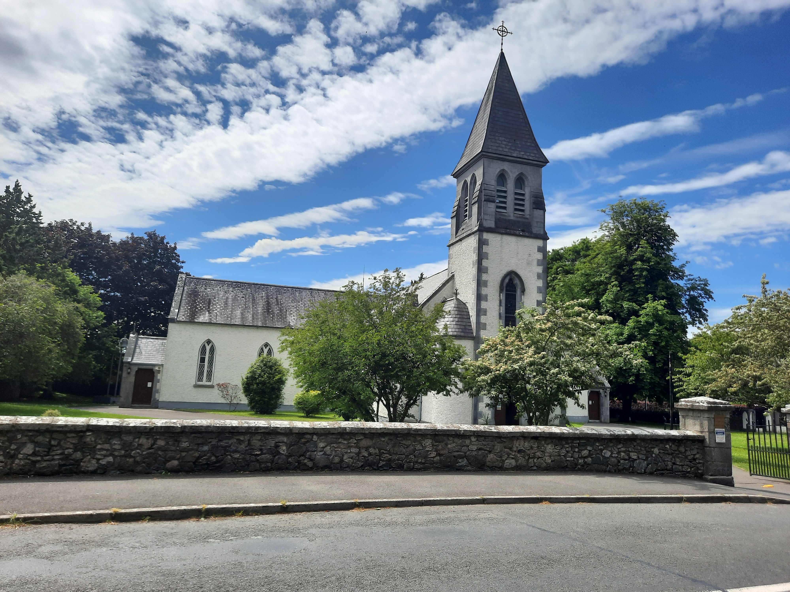


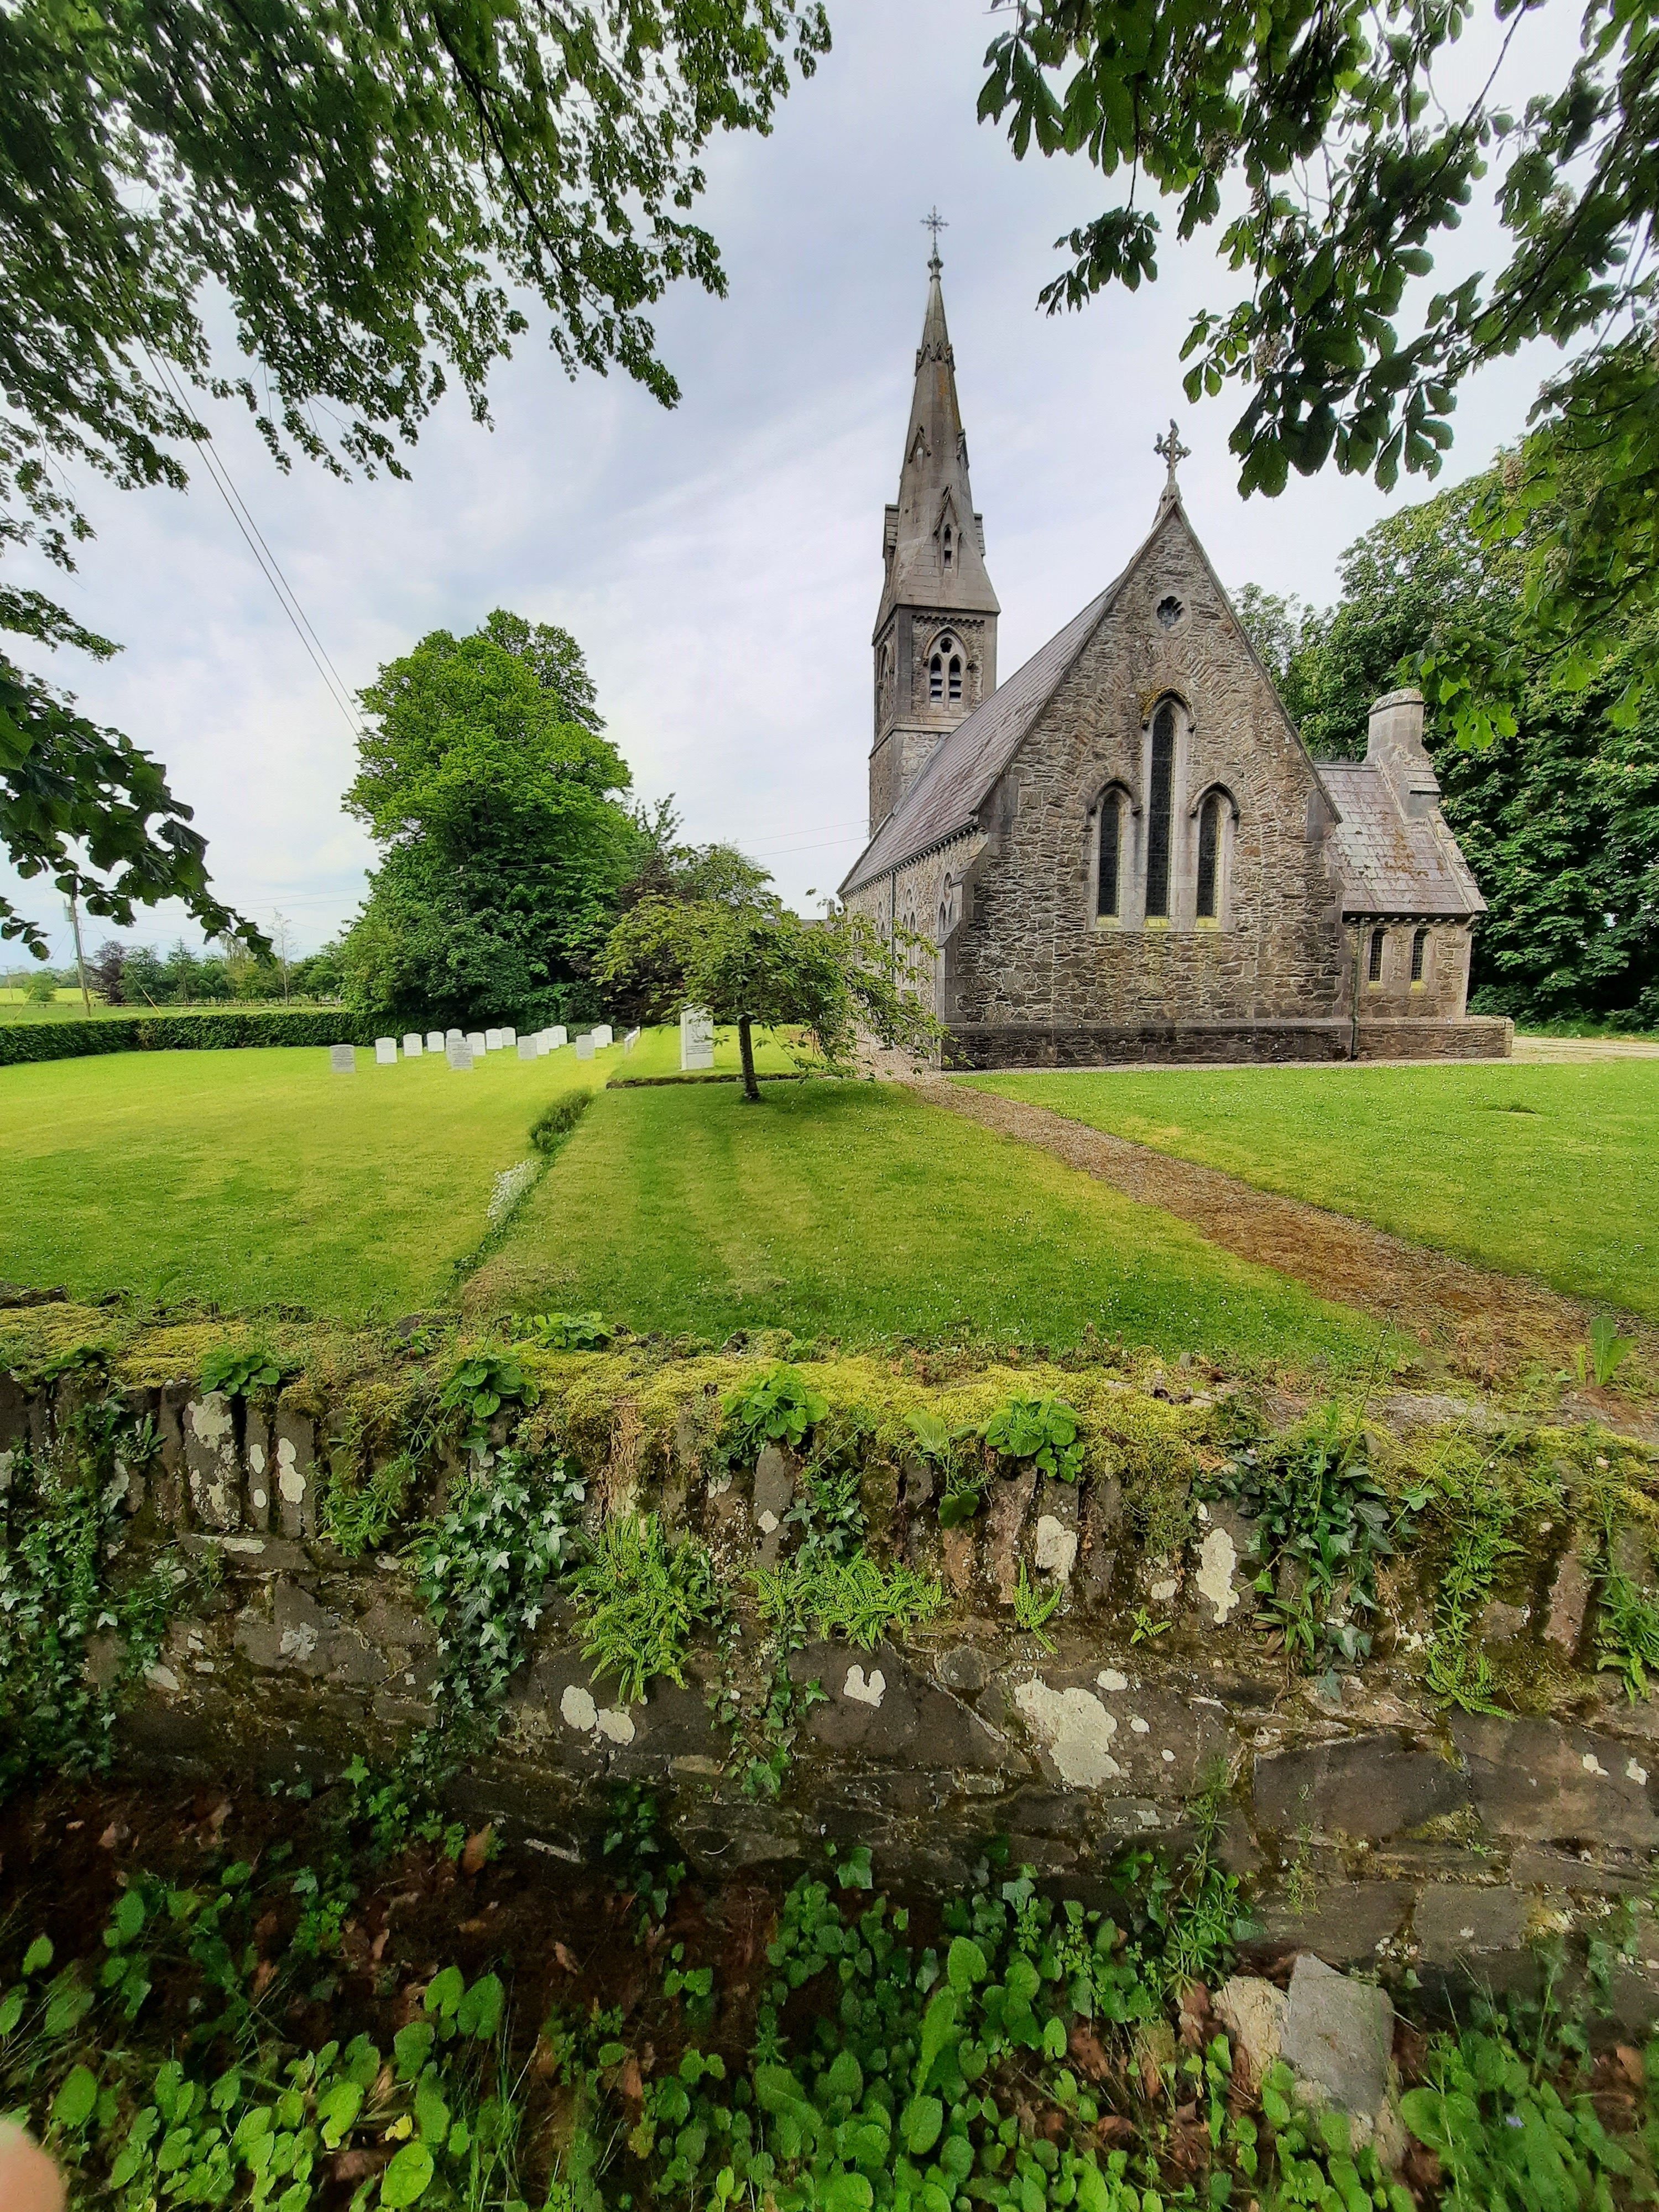


Villages
Allenwood, Athgarvan, Ballitore, Ballymore Eustace, Caragh, Coill Dubh / Cooleragh, Crookstown,
Johnstown, Johnstownbridge, Kildangan, Kilmeague, Moone, Narraghmore, Robertstown, Straffan,
Suncroft, Timolin.
Facilitate sustainable population growth in the identified Rural Settlements to cater primarily for local demands.
Local demand is defined as:
Kildangan
Settlements
5 years
Allen, Ardclough, Ballyshannon, Broadford, Brannockstown, Brownstown, Calverstown, Clogharinka, Cutbush, Kilberry, Kilkea, Kilmead, Kilteel, Maganey / Levistown, Milltown, Nurney, Rathcoffey, Staplestown,
Two Mile House.
10km radius of the site.
‘Primarily for local demand’ shall be defined as being in excess of 50% of the overall development.
Kilkea
Notes:
…………..persons residing for a period of 5 years within a 10km radius of the site.

Slide 44




Villages and Rural Settlements
Develop lands in both the villages and rural settlements sequentially and generally in accordance with the following:
Development will be encouraged from the centre outwards with undeveloped lands closest to the centres being given first priority.
‘Leap-frogging’ will be strongly resisted.
Phasing of individual developments may be conditioned as part of a grant of planning permission in villages/rural settlements.
The development of ‘infill’ sites and lands with opportunities for brownfield/regeneration will be encouraged.

Slide 45
Thank you
The Draft Kildare County Development Plan is on public display for a period of 10 weeks (14th March to the 24th of May 2022).
Make a Submission / Observation before 4pm on the 24th May 2022 .

